Slide 1
Chapter 14 File Processing
C++ How to Program, 9/e

Slide 2
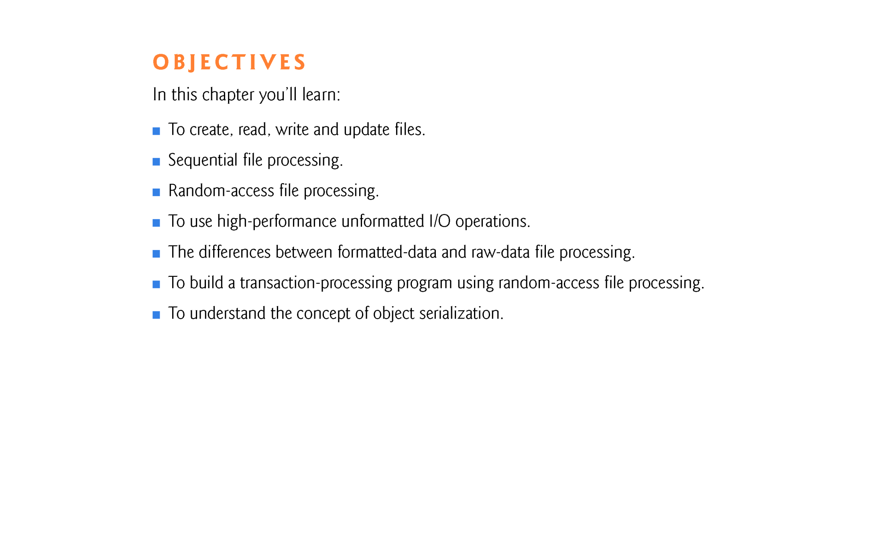

Slide 3
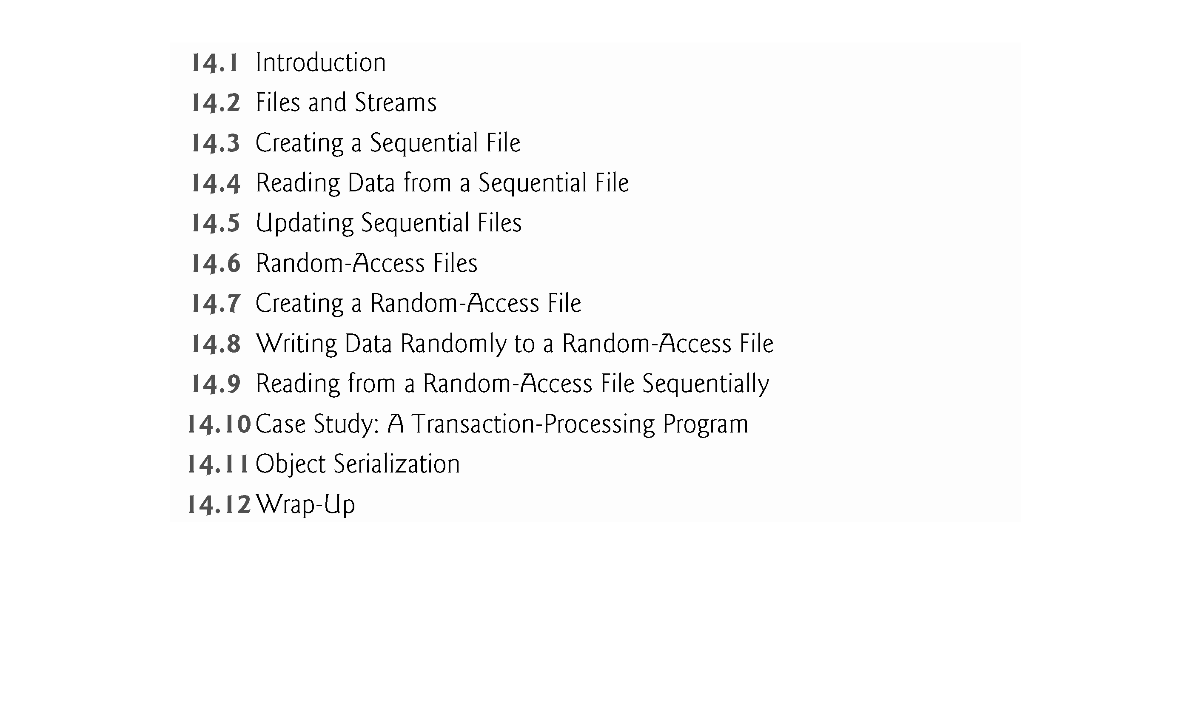

Slide 4
14.1 Introduction
Storage of data in memory is temporary.
Files are used for data persistence - permanent retention of data.
Computers store files on secondary storage devices, such as hard disks, CDs, DVDs, flash drives and tapes.
In this chapter, we explain how to build C++ programs that create, update and process data files.
We consider both sequential files and random-access files.
We compare formatted-data file processing and raw-data file processing.

Slide 5
14.2 Files and Streams
C++ views each file as a sequence of bytes (Fig. 14.1).
Each file ends either with an end-of-file marker or at a specific byte number recorded in an operating-system-maintained, administrative data structure.
When a file is opened, an object is created, and a stream is associated with the object.
In Chapter 13, we saw that objects cin, cout, cerr and clog are created when <iostream> is included.
The streams associated with these objects provide communication channels between a program and a particular file or device.

Slide 6
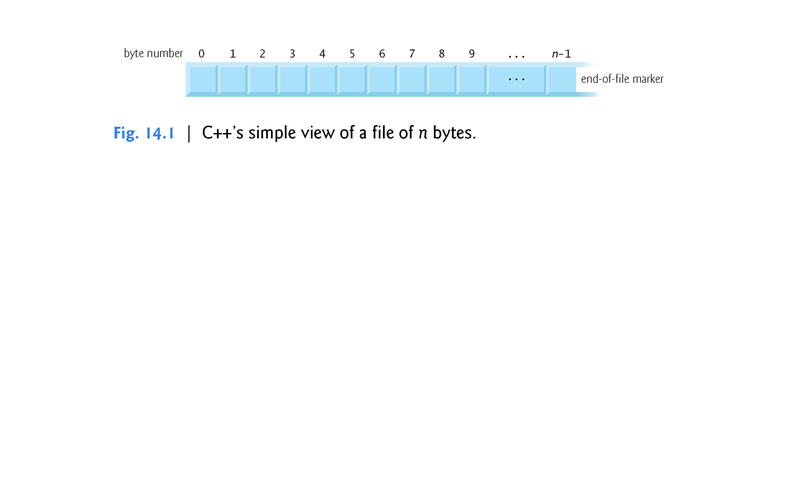

Slide 7
14.2 Files and Streams (cont.)
File-Processing Class Templates
To perform file processing in C++, headers <iostream> and <fstream> must be included.
Header <fstream> includes the definitions for the stream class templates basic_ifstream (for file input), basic_ofstream (for file output) and basic_fstream (for file input and output).
Each class template has a predefined template specialization that enables char I/O.

Slide 8
14.2 Files and Streams (cont.)
The <fstream> library provides typedef aliases for these template specializations.
The typedef ifstream represents a specialization of basic_ifstream that enables char input from a file.
The typedef ofstream represents a specialization of basic_ofstream that enables char output to files.
The typedef fstream represents a specialization of basic_fstream that enables char input from, and output to, files.

Slide 9
14.2 Files and Streams (cont.)
These templates derive from class templates basic_istream, basic_ostream and basic_iostream, respectively.
Thus, all member functions, operators and manipulators that belong to these templates (which we described in Chapter 13) also can be applied to file streams.
Figure 14.2 summarizes the inheritance relationships of the I/O classes that we’ve discussed to this point.

Slide 10
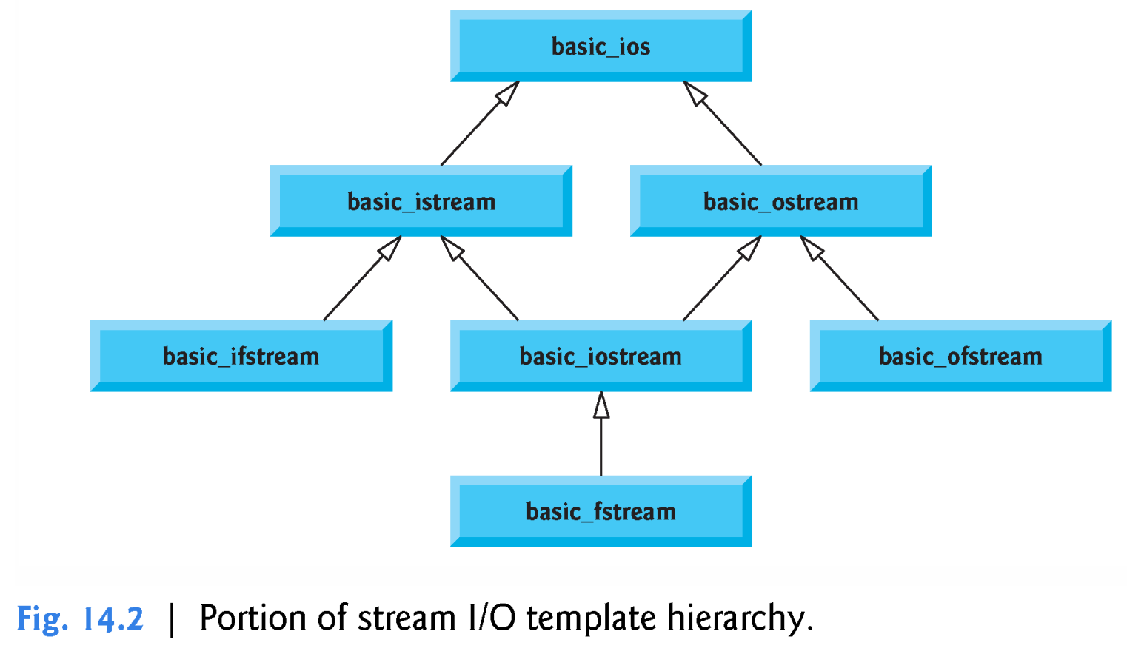

Slide 11
14.3 Creating a Sequential File
C++ imposes no structure on a file.
Thus, a concept like that of a “record” does not exist in a C++ file.
You must structure files to meet the application’s requirements.
Figure 14.3 creates a sequential file that might be used in an accounts-receivable system to help manage the money owed to a company’s credit clients.
For each client, the program obtains the client’s account number, name and balance (i.e., the amount the client owes the company for goods and services received in the past).
The data obtained for each client constitutes a record for that client.
The account number serves as the record key.
This program assumes the user enters the records in account number order.
In a comprehensive accounts receivable system, a sorting capability would be provided to eliminate this restriction.

Slide 12
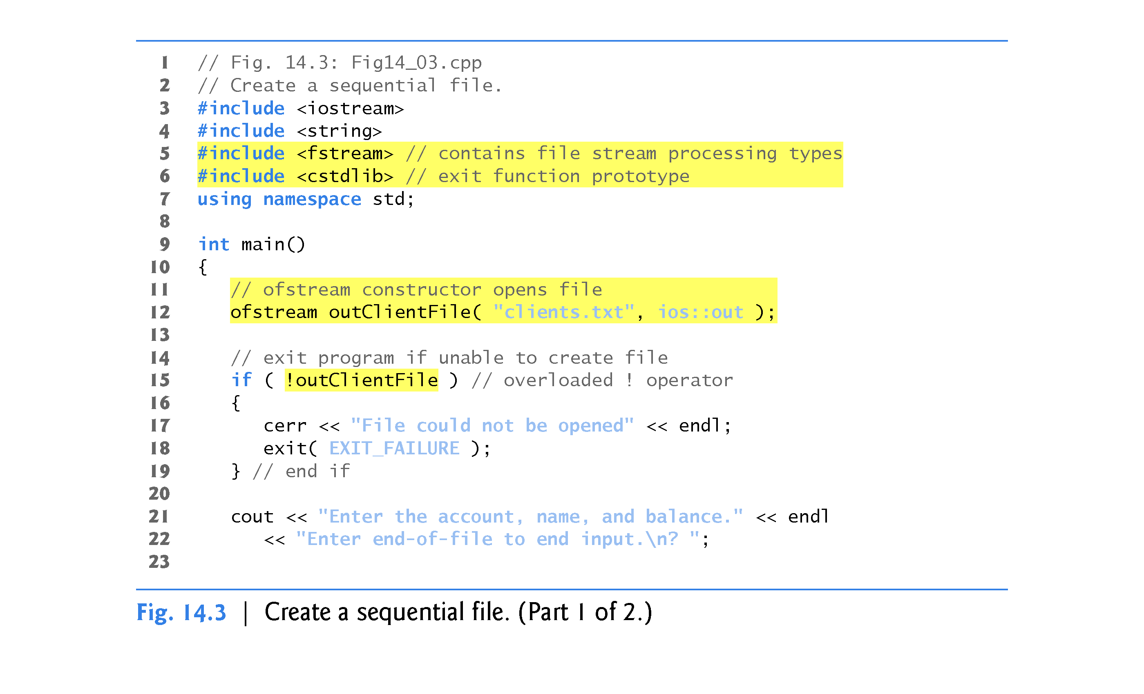

Slide 13
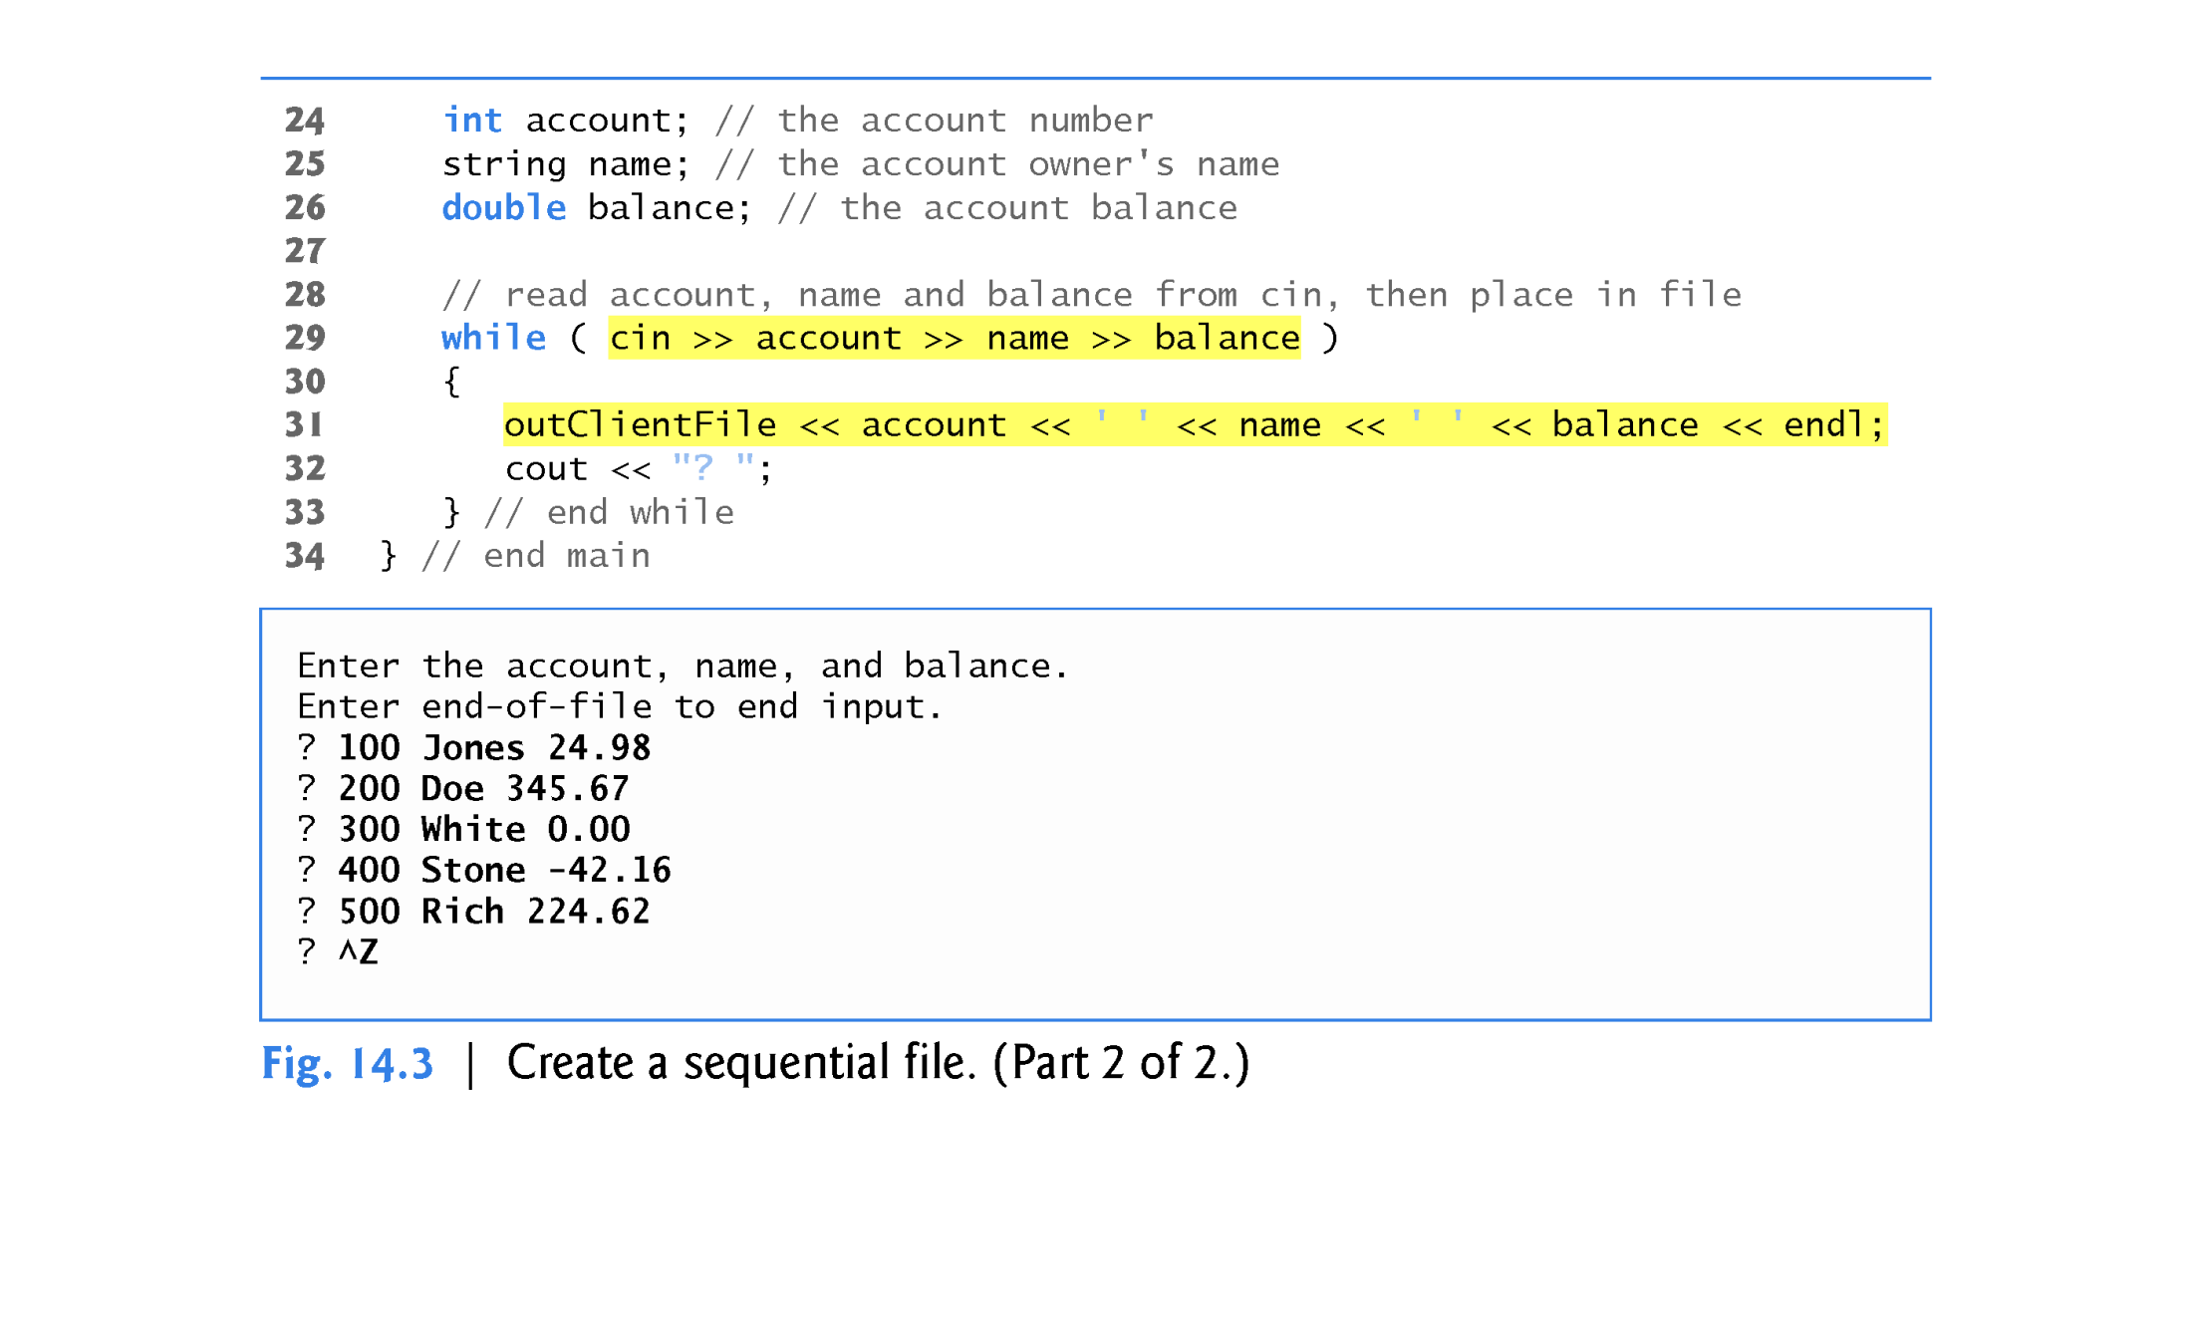
//true till <EOF>
Interesting…
no outClientFile.close(); but output buffer is flushed and file is closed because of use of >> in condition for the while loop!

Slide 14
14.3 Creating a Sequential File (cont.)
Opening a File
Figure 14.3 writes data to a file so we open the file output by creating an ofstream object.
Two arguments are passed to the object’s constructor—the filename and the file-open mode (line 12).
For an ofstream object, the file-open mode can be either ios::out (the default) to output data to a file or ios::app to append data to the end of a file (without modifying any data already in the file).
Since ios::out is the default, the second constructor argument in line 12 is not required.
Existing files opened with mode ios::out are truncated—all data in the file is discarded.
If the specified file does not yet exist, then the ofstream object creates the file, using that filename.
Prior to C++11, the filename was specified as a pointer-based string - as of C++11, it can also be specified as a string object.

Slide 15
14.3 Creating a Sequential File (cont.)
The ofstream constructor opens the file—this establishes a “line of communication” with the file.
By default, ofstream objects are opened for output, so the open mode is not required in the constructor call.
Figure 14.4 lists the file-open modes.

Slide 16
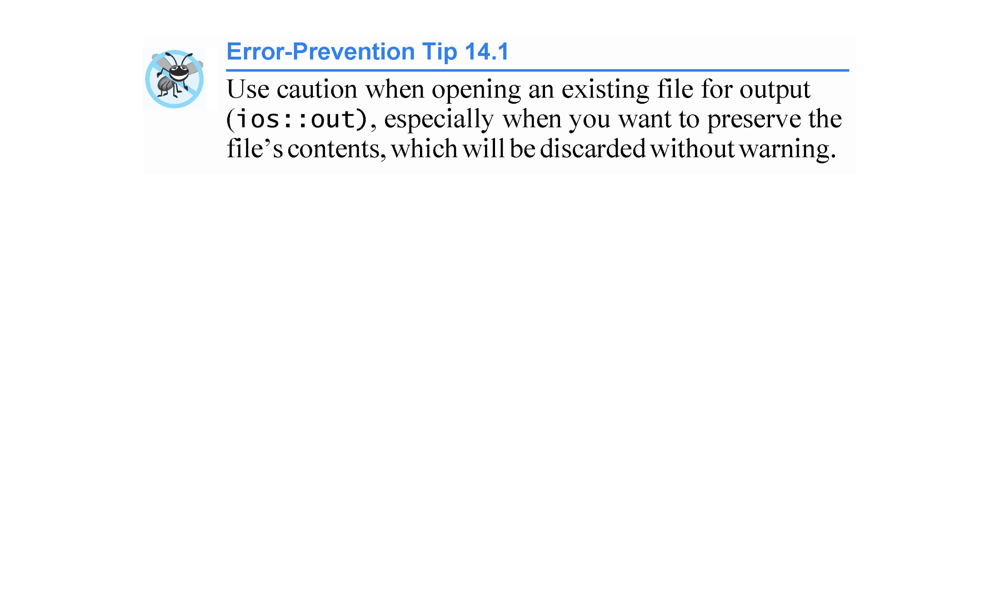

Slide 17
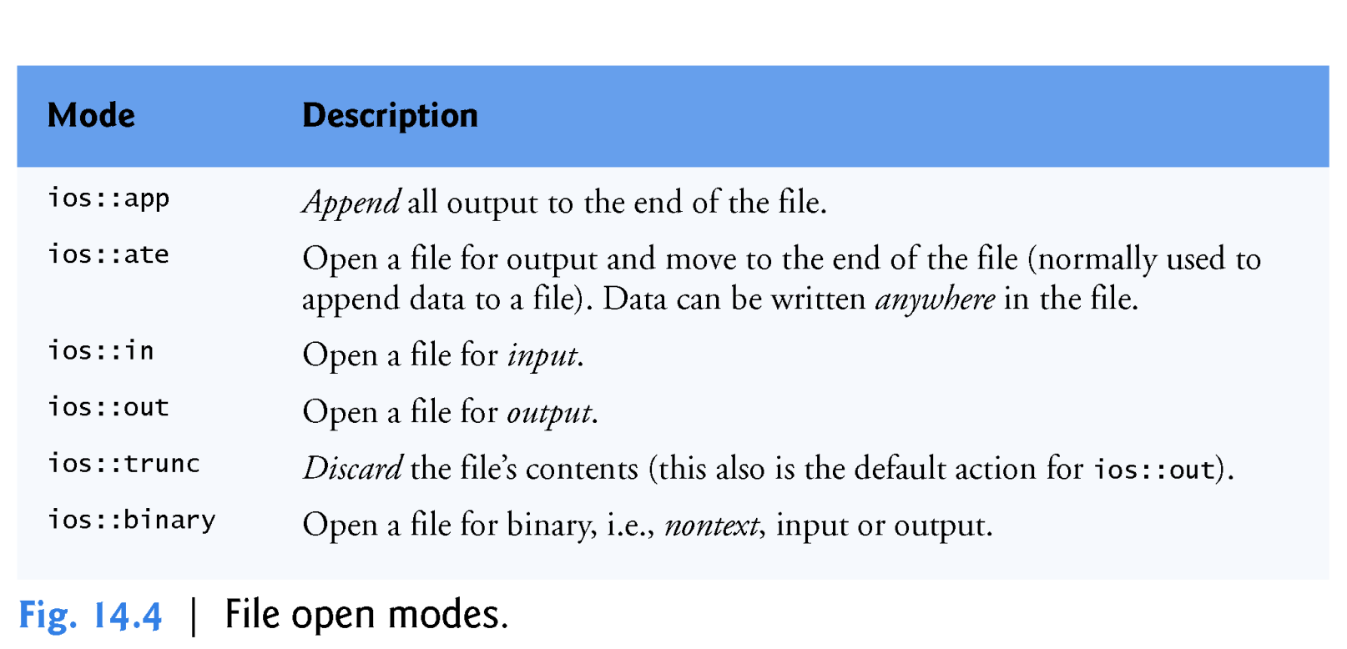

Slide 18
14.3 Creating a Sequential File (cont.)
Opening a File via the open Member Function
You can create an ofstream object without opening a specific file - in this case, a file can be attached to the object later.
For example, the statement
ofstream outClientFile;
creates an ofstream object that’s not yet associated with a file.
The ofstream member function open opens a file and attaches it to an existing ofstream object as follows:
outClientFile.open("clients.dat", ios::out);

Slide 19
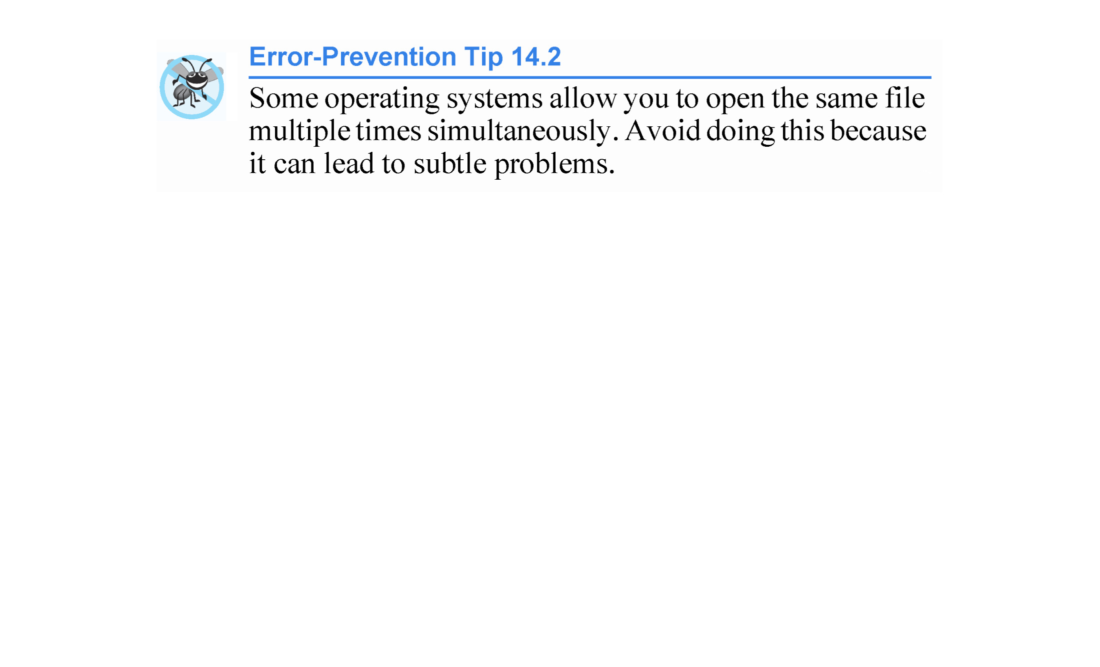

Slide 20
14.3 Creating a Sequential File (cont.)
Testing Whether a File Was Opened Successfully
After creating an ofstream object and attempting to open it, the program tests whether the open operation was successful.
The if statement in lines 15–19 uses the overloaded ios member function operator! to determine whether the open operation succeeded.
The condition returns a true value if either the failbit or the badbit is set for the stream on the open operation.
Some possible errors are
attempting to open a nonexistent file for reading,
attempting to open a file for reading or writing with-out permission
opening a file for writing when no disk space is available.

Slide 21
14.3 Creating a Sequential File (cont.)
Function exit terminates a program.
The argument to exit is returned to the environment from which the program was invoked.
Passing EXIT_SUCCESS (also defined in <cstdlib>) to exit indicates that the program terminated normally; passing any other value (in this case EXIT_FAILURE) indicates that the program terminated due to an error.

Slide 22
14.3 Creating a Sequential File (cont.)
The Overloaded void * Operator
Another overloaded ios member function - operator void * - converts the stream to a pointer, so it can be tested as 0 (i.e., the null pointer) or nonzero (i.e., any other pointer value).
When a pointer value is used as a condition, C++ interprets a null pointer in a condition as the bool value false and interprets a non-null pointer as the bool value true.
If the failbit or badbit has been set for the stream, 0 (false) is returned.
The condition in the while statement of lines 29–33 invokes the operator void * member function on cin implicitly.
The condition remains true as long as neither the failbit nor the badbit has been set for cin.
Entering the end-of-file indicator sets the failbit for cin.

Slide 23
14.3 Creating a Sequential File (cont.)
The operator void * function can be used to test an input object for end-of-file, but you can also call member function eof on the input object.
Processing Data
Figure 14.5 lists the keyboard combinations for entering end-of-file for various computer systems.

Slide 24
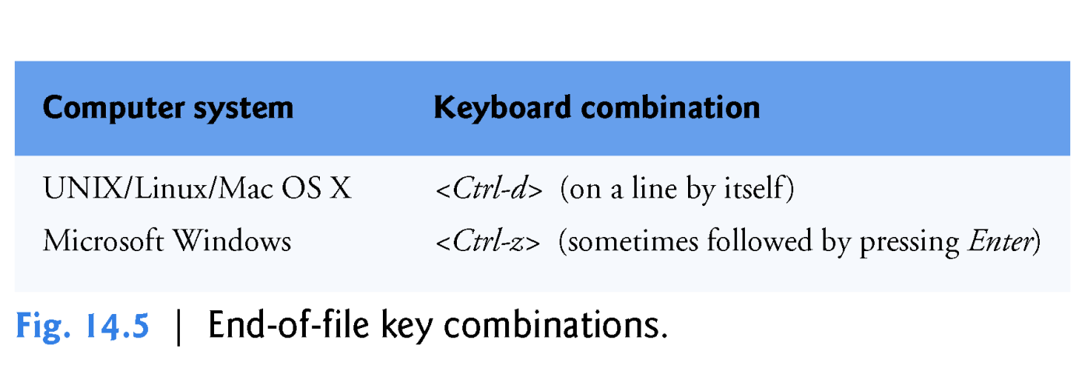

Slide 25
14.3 Creating a Sequential File (cont.)
When end-of-file is encountered or bad data is entered, operator void * returns the null pointer (which converts to the bool value false) and the while statement terminates.
The user enters end-of-file to inform the program to process no additional data.
The end-of-file indicator is set when the user enters the end-of-file key combination.
Line 31 writes a set of data to the file clients.txt, using the stream insertion operator << and the outClientFile object associated with the file at the beginning of the program.
The data may be retrieved by a program designed to read the file (see Section 14.4).
The file created in Fig. 14.3 is simply a text file, so it can be viewed by any text editor.

Slide 26
14.3 Creating a Sequential File (cont.)
Closing a File
Once the user enters the end-of-file indicator, main terminates.
This implicitly invokes outClientFile’s destructor, which closes the clients.txt file.
You also can close the ofstream object explicitly, using member function close.

Slide 27
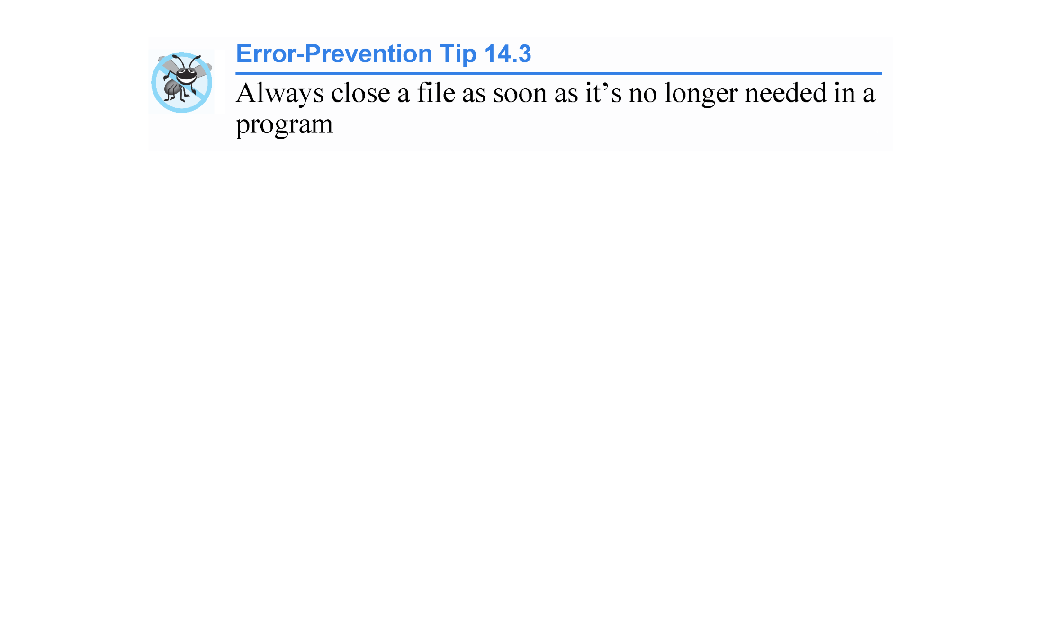

Slide 28
14.4 Reading Data from a Sequential File
Files store data so it may be retrieved for processing when needed.
In this section, we discuss how to read data sequentially from a file.
Figure 14.6 reads records from the clients.txt file that we created using the program of Fig. 14.3 and displays the contents of these records.

Slide 29
14.4 Reading Data from a Sequential File
Creating an ifstream object opens a file for input.
The ifstream constructor can receive the filename and the file open mode as arguments.
Line 15 creates an ifstream object called inClientFile and associates it with the clients.txt file.
The arguments in parentheses are passed to the ifstream constructor function, which opens the file and establishes a “line of communication” with the file.

Slide 30
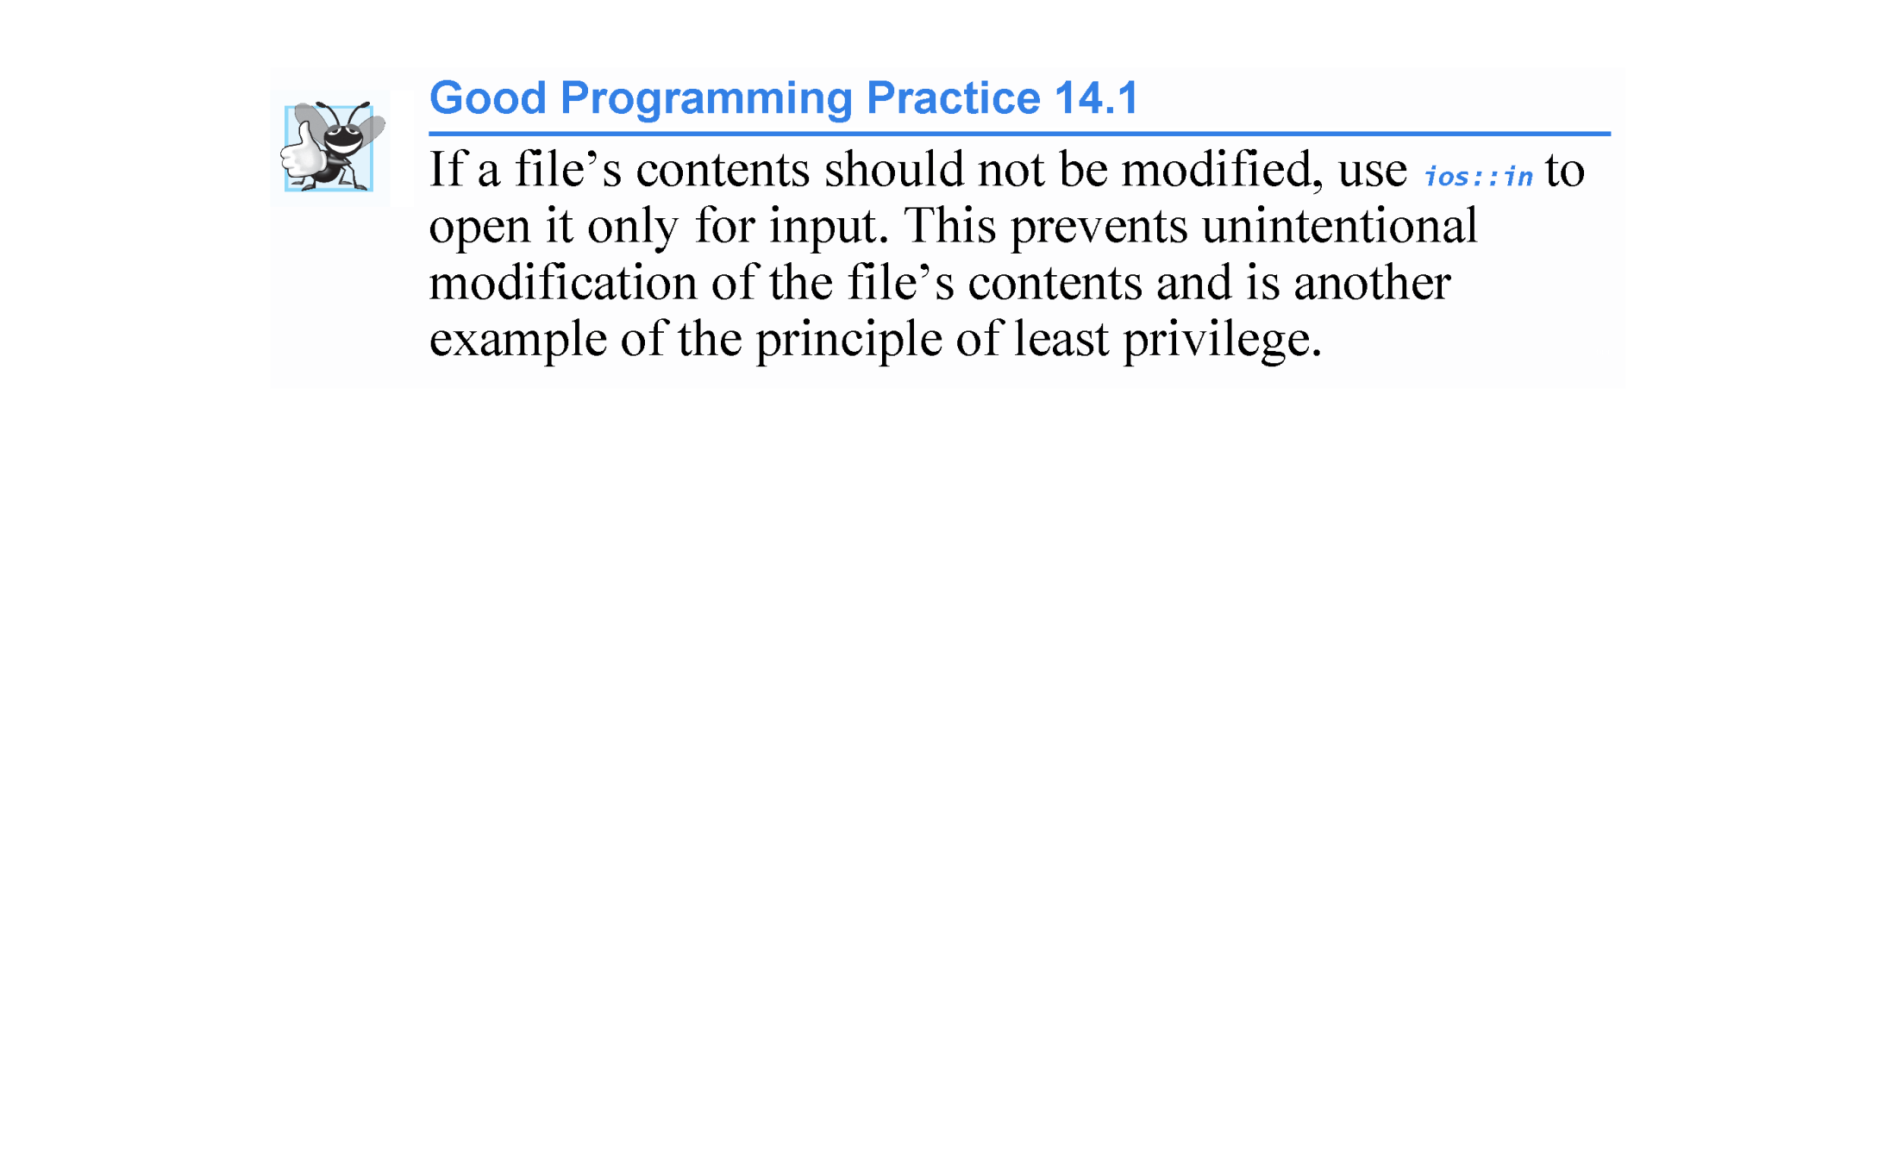
ios::in should be the default for a file opened for input

Slide 31
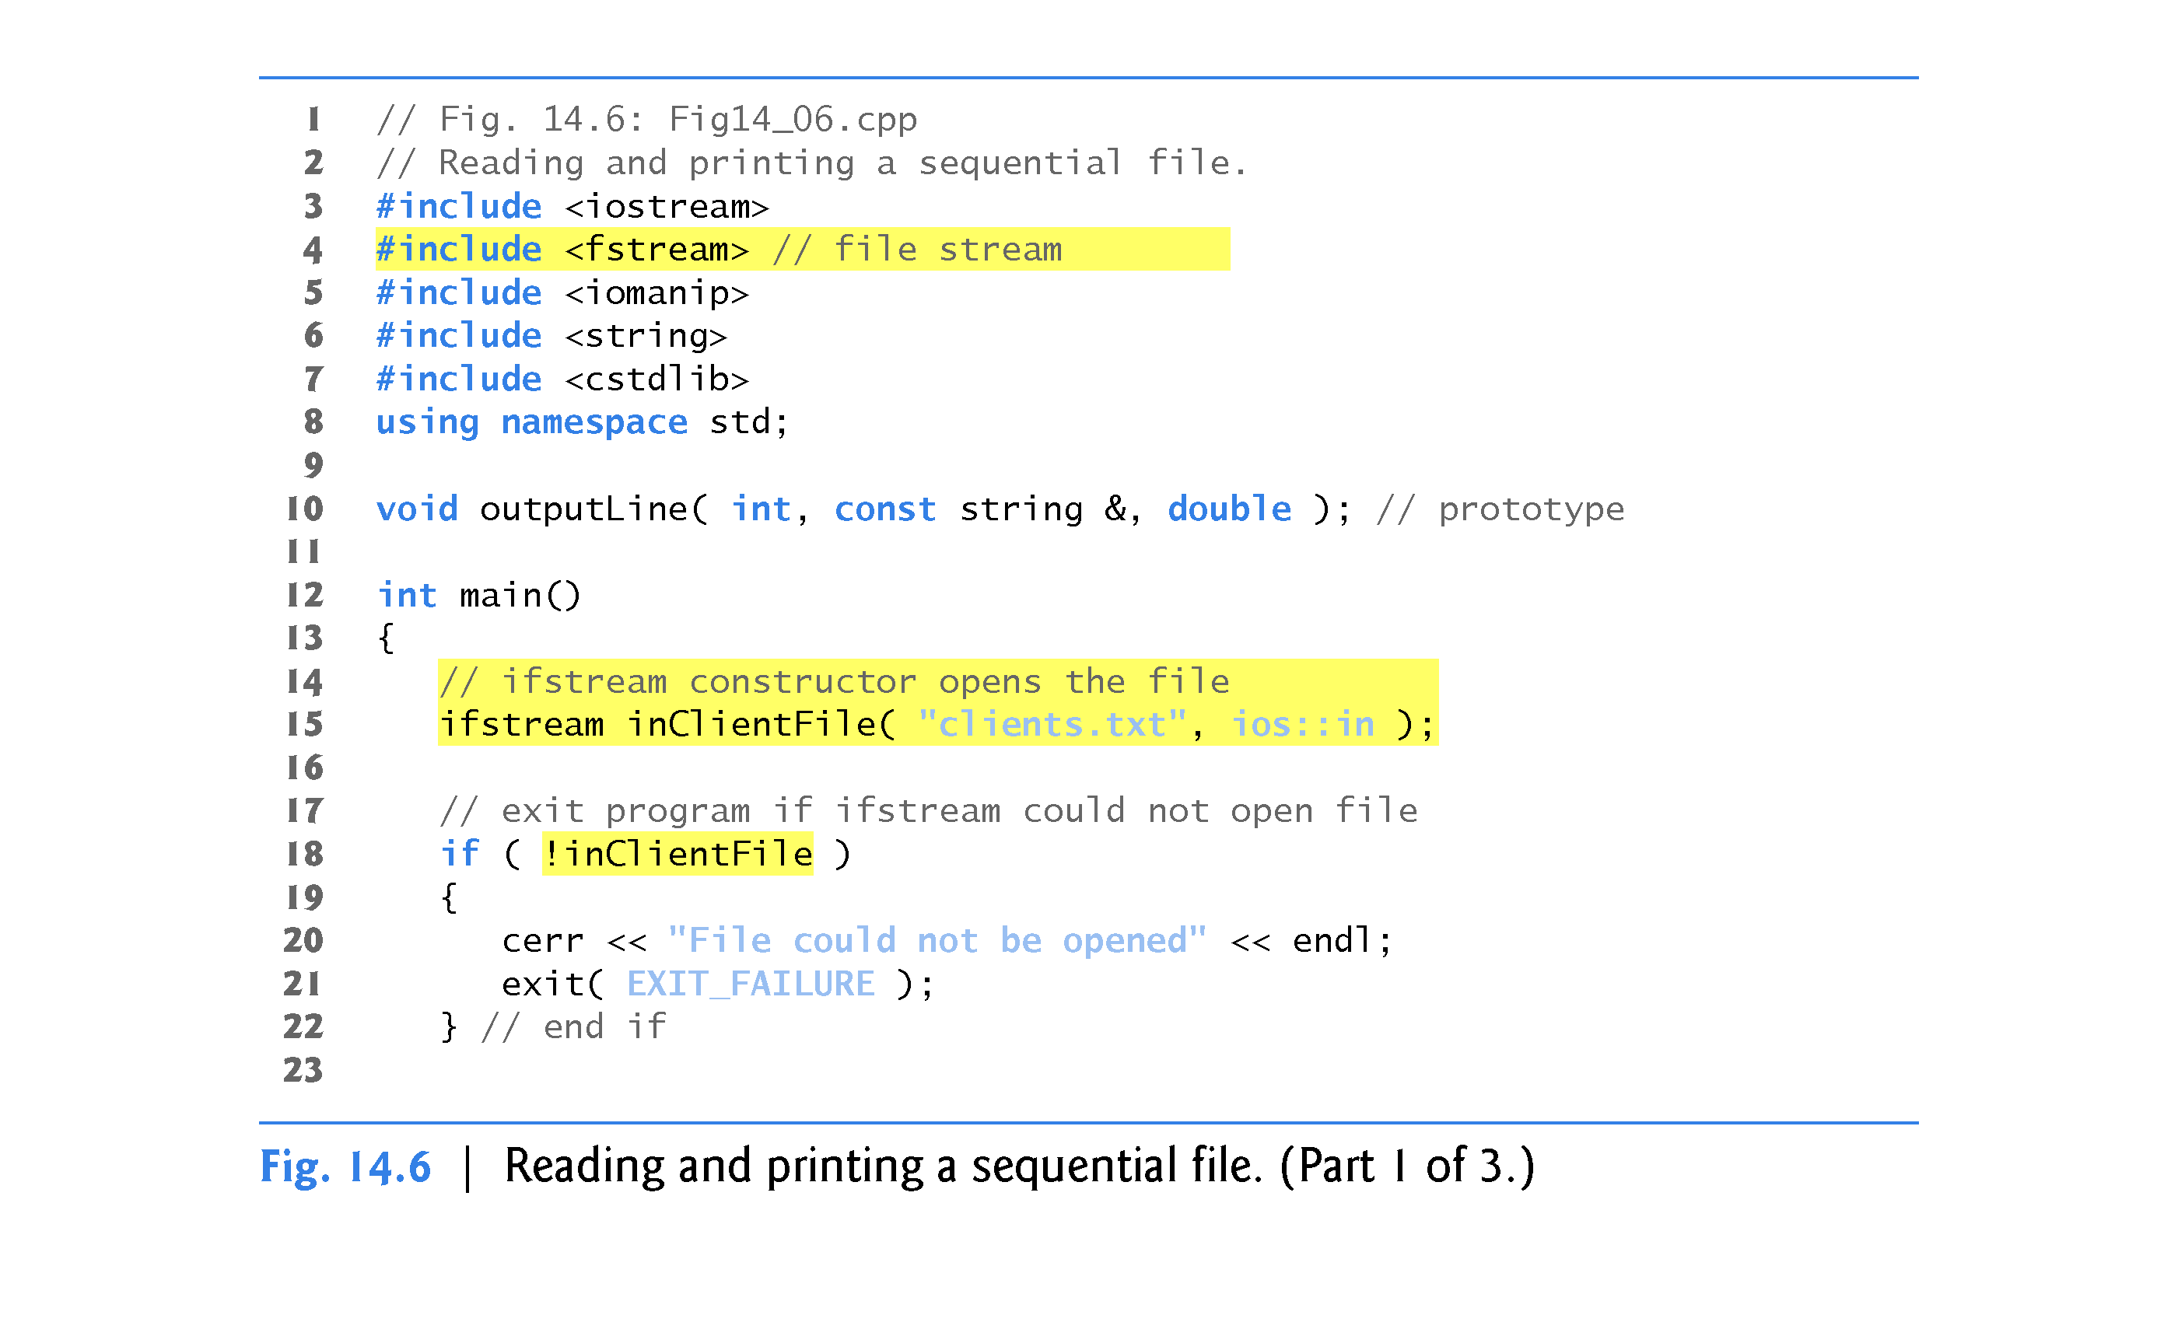
//Test for a null pointer (bool 0 value)

Slide 32
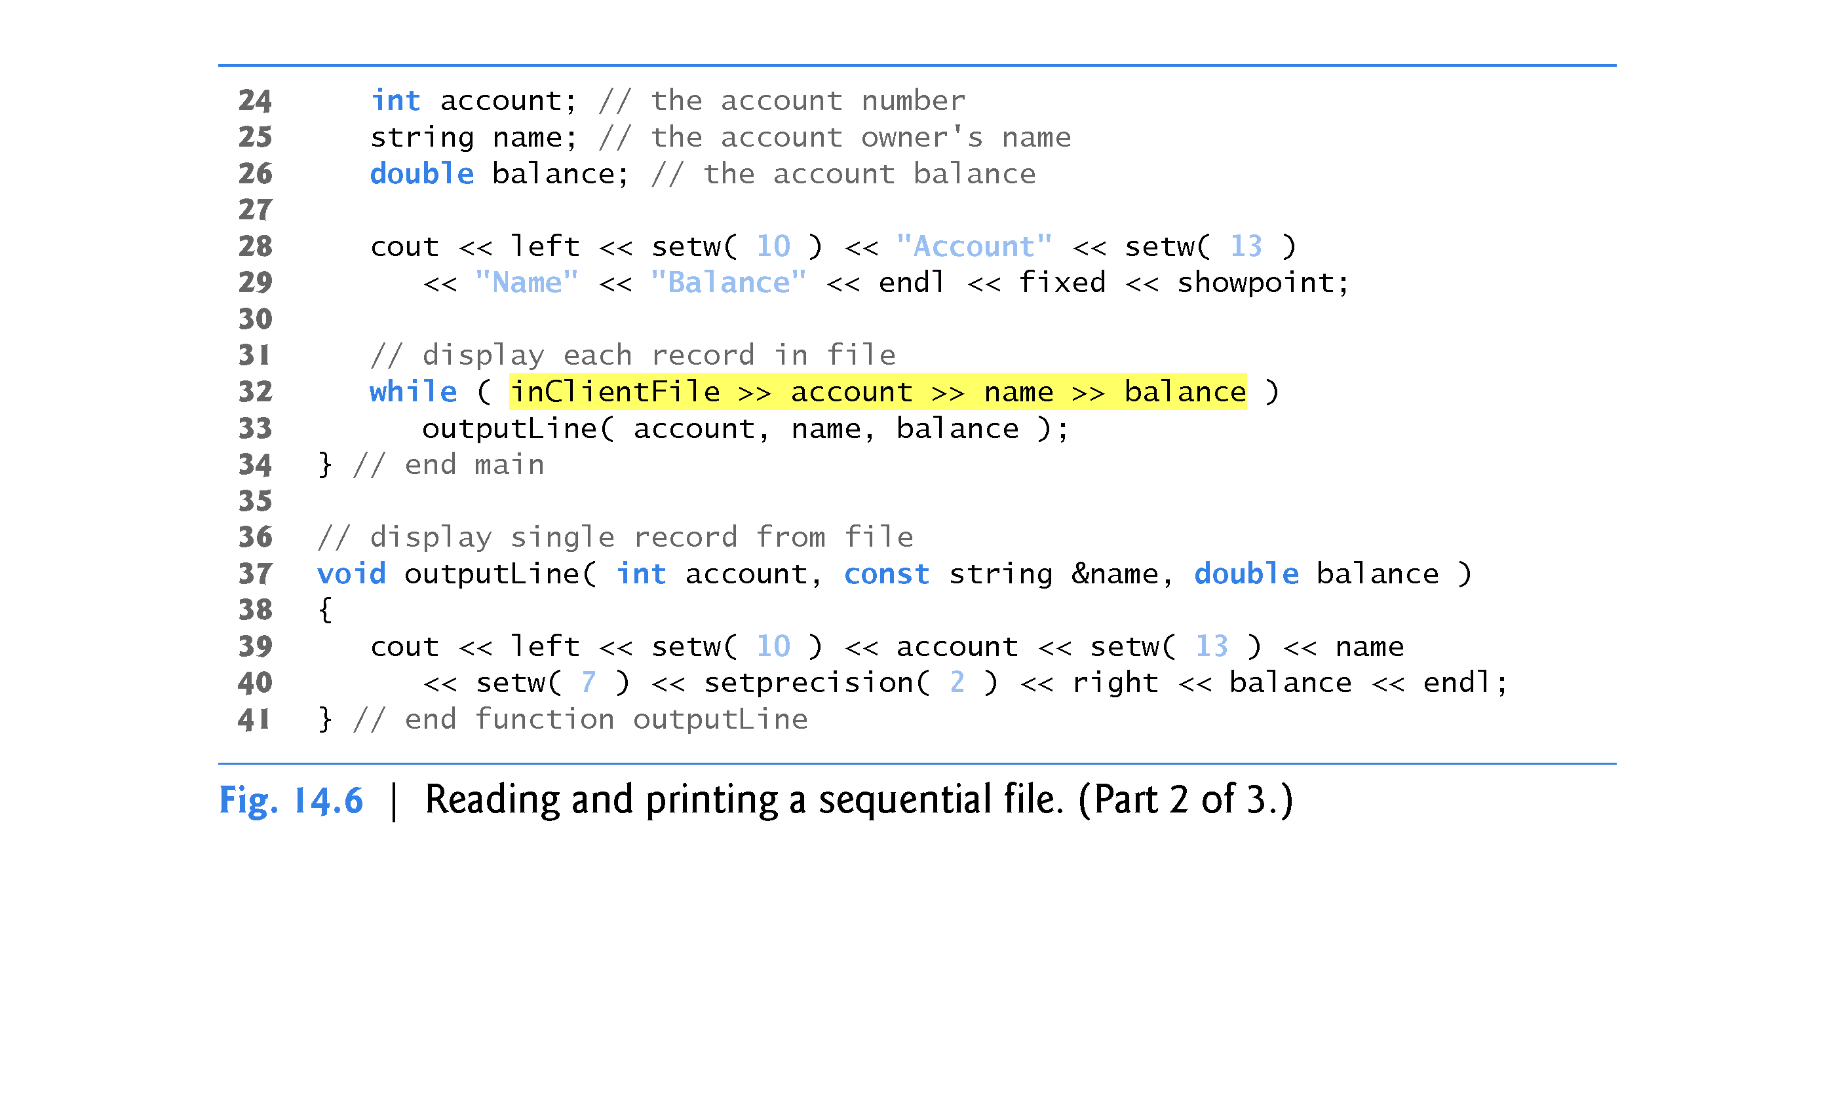

Slide 33
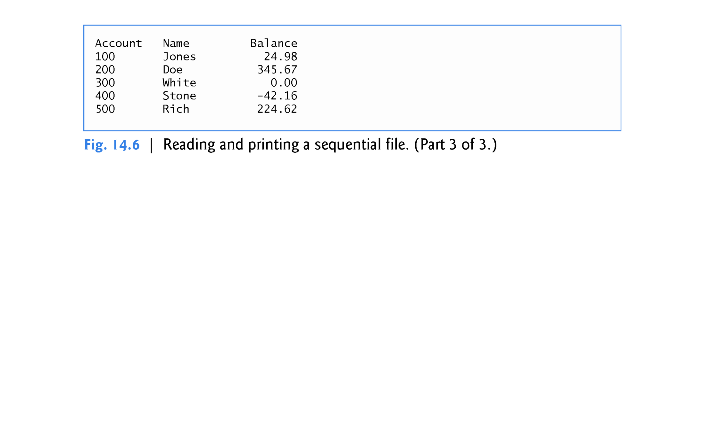

Slide 34
14.4 Reading Data from a Sequential File
Opening a File for Input
Objects of class ifstream are opened for input by default.
We could have used the statement
ifstream inClientFile( "clients.txt" );
to open clients.dat for input.
Just as with an ofstream object, an ifstream object can be created without opening a specific file, because a file can be attached to it later.

Slide 35
14.4 Reading Data from a Sequential File
Reading from the File
Line 32 reads a set of data (i.e., a record) from the file.
Each time line 32 executes, it reads another record from the file into the variables account, name and balance.
When the end of file has been reached, the implicit call to operator void * in the while condition returns the null pointer (which converts to the bool value false), the ifstream destructor function closes the file and the program terminates.

Slide 36
14.4 Reading Data from a Sequential File (cont.)
File Position Pointers
To retrieve data sequentially from a file, programs normally start reading from the beginning of the file and read all the data consecutively until the desired data is found.
It might be necessary to process the file sequentially several times (from the beginning of the file) during the execution of a program.
Both istream and ostream provide member functions for repositioning the file-position pointer (the byte number of the next byte in the file to be read or written).
seekg (“seek get”) for ifstream
seekp (“seek put”) for ofstream

Slide 37
14.4 Reading Data from a Sequential File
Each istream object has a get pointer, which indicates the byte number in the file from which the next input is to occur, and each ostream object has a put pointer, which indicates the byte number in the file at which the next output should be placed.
The statement
inClientFile.seekg( 0l ); //long 0
repositions the file-position pointer to the beginning of the file (location 0) attached to inClientFile.
The argument to seekg normally is a long integer.

Slide 38
14.4 Reading Data from a Sequential File
A second argument can be specified to indicate the seek direction, which can be
ios::beg (the default) for positioning relative to the beginning of a stream,
ios::cur for positioning relative to the current position in a stream or
ios::end for positioning relative to the end of a stream
The file-position pointer is an integer value that specifies the location in the file as a number of bytes from the file’s starting location (this is also referred to as the offset from the beginning of the file).

Slide 39
14.4 Reading Data from a Sequential File
Some examples of positioning the get file-position pointer are
// position to the nth byte of fileObject (assumes ios::beg) fileObject.seekg( n );
// position n bytes forward in fileObject fileObject.seekg( n, ios::cur );
// position n bytes back from end of fileObject fileObject.seekg( n, ios::end );
// position at end of fileObject fileObject.seekg( 0, ios::end );
The same operations can be performed using ostream member function seekp.

Slide 40
14.4 Reading Data from a Sequential File
Member functions tellg and tellp are provided to return the current locations of the get and put pointers, respectively.

Slide 41
14.4 Reading Data from a Sequential File
Credit Inquiry Program
Figure 14.7 enables a credit manager to display the account information for those customers with
zero balances (i.e., customers who do not owe the company any money),
credit (negative) balances (i.e., customers to whom the company owes money), and
debit (positive) balances (i.e., customers who owe the company money for goods and services received in the past)

Slide 42
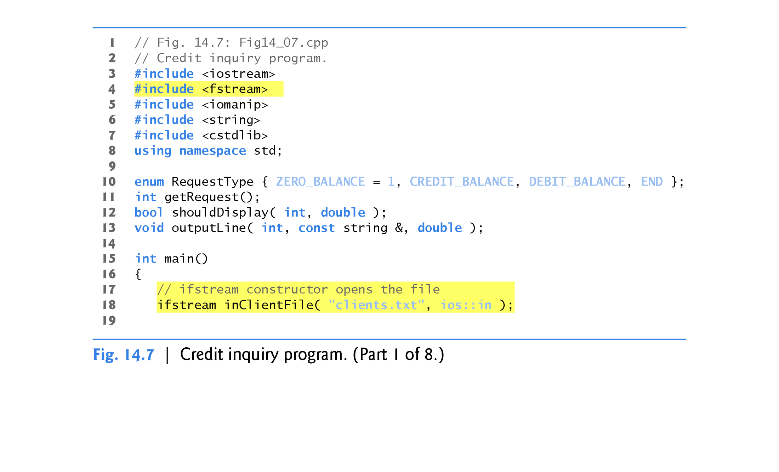

Slide 43
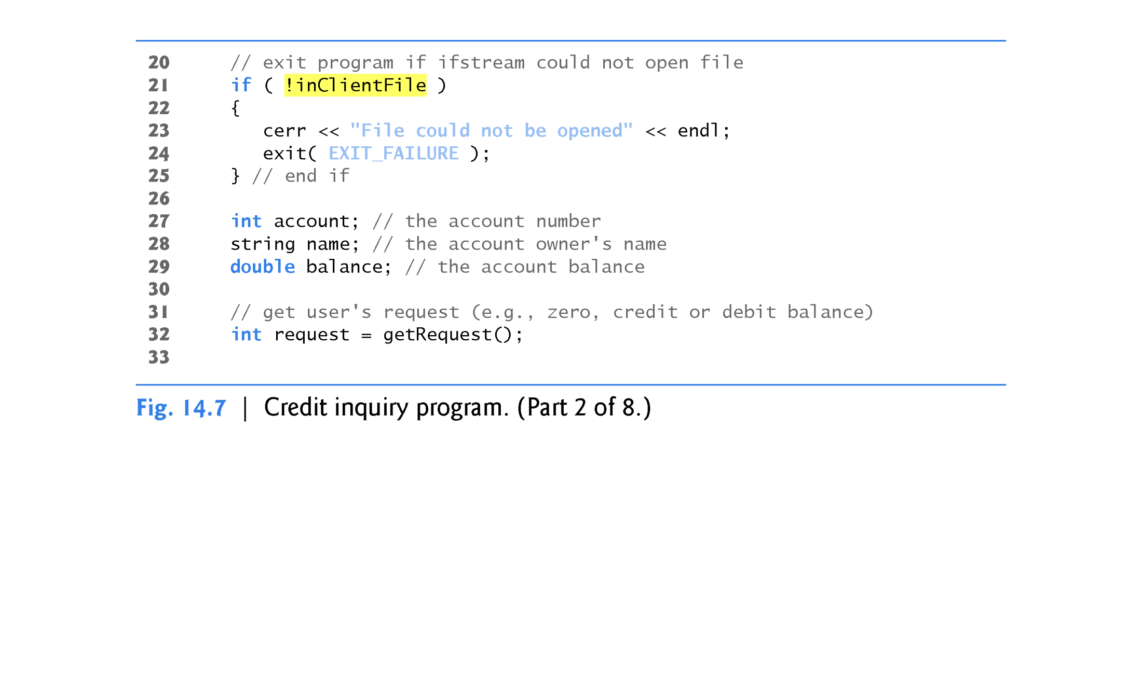

Slide 44
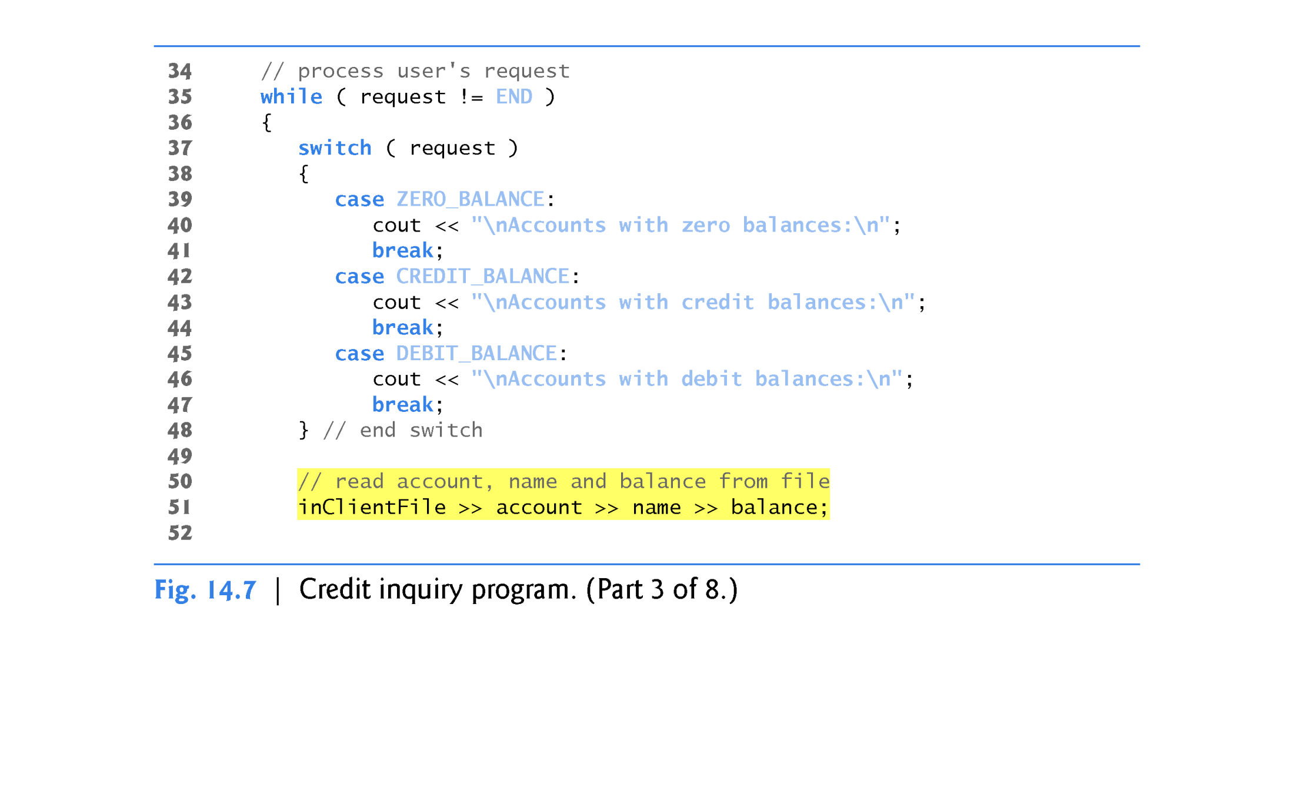

Slide 45
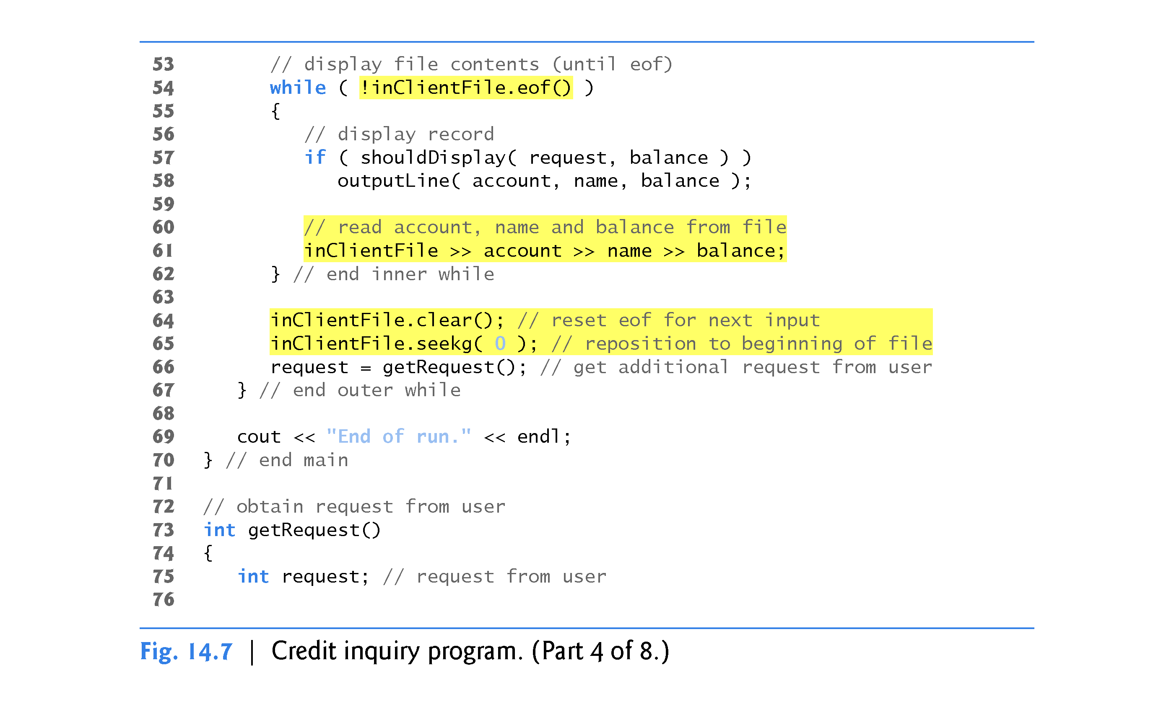

Slide 46
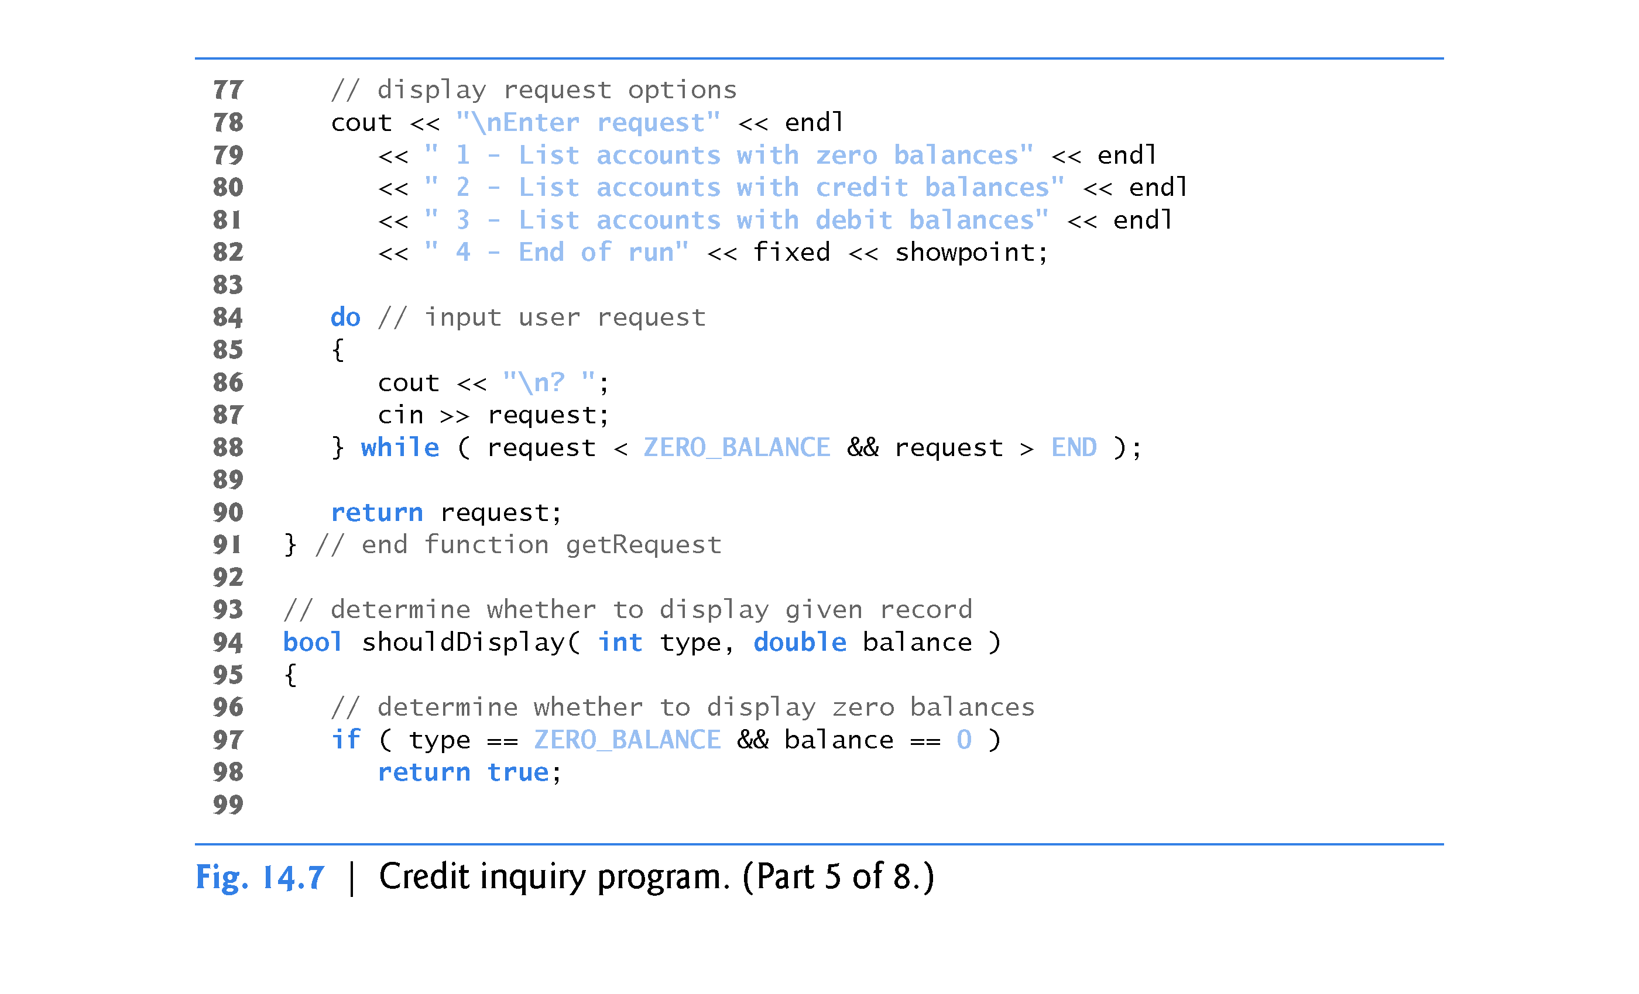
this test will always fail!
Logical operator should be OR ( || )

Slide 47
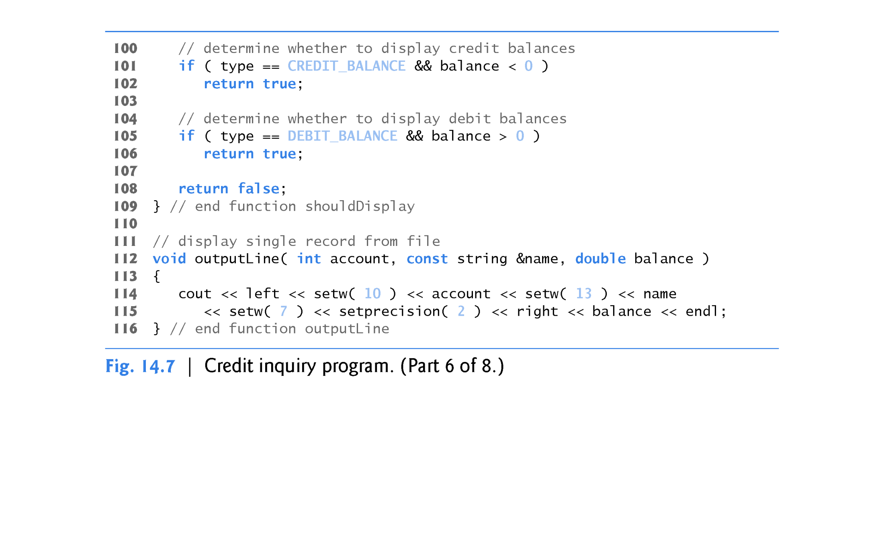

Slide 48
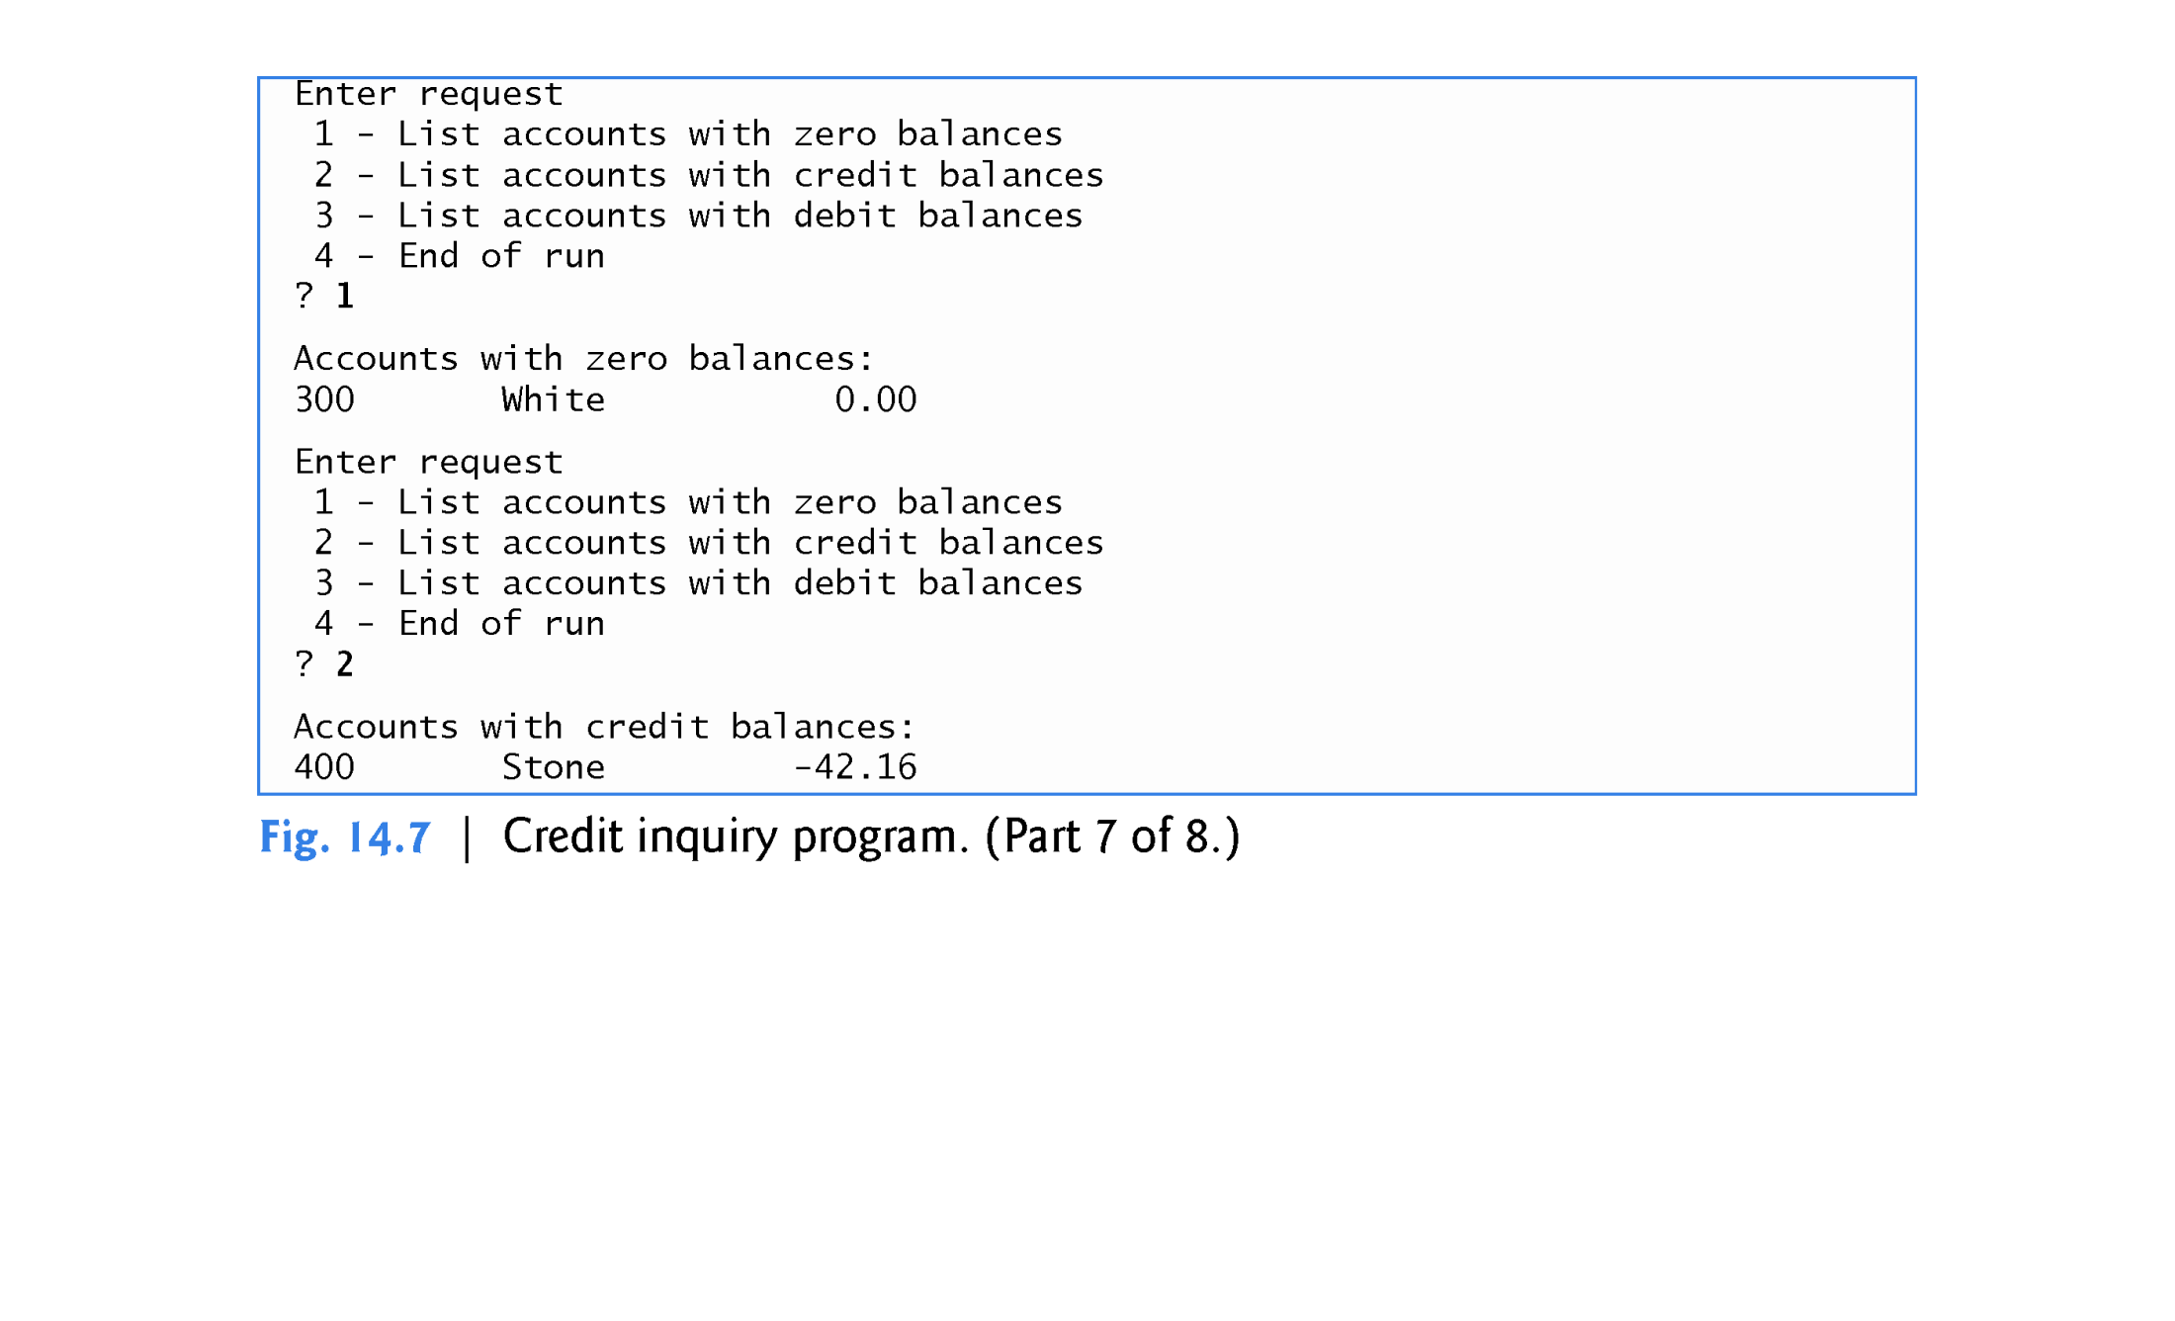

Slide 49
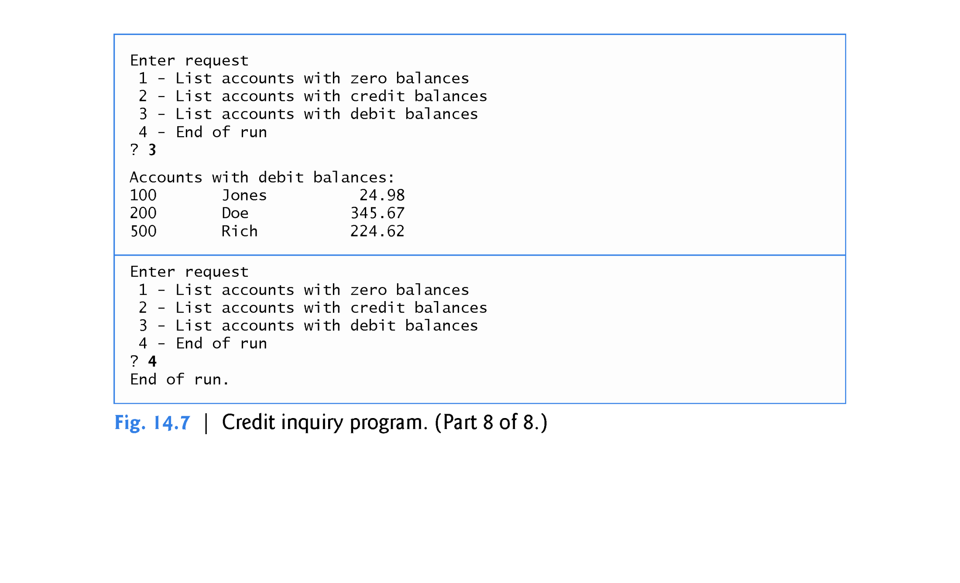

Slide 50
14.5 Updating Sequential Files
Data that is formatted and written to a sequential file as shown in Section 14.3 cannot be modified without the risk of destroying other data in the file.
For example, if the name “White” needs to be changed to “Worthington,” the old name cannot be overwritten without corrupting the file.
The record for White was written to the file as
300 White 0.00
If this record were rewritten beginning at the same location in the file using the longer name, the record would be
300 Worthington 0.00
The new record contains six more characters than the original record.
Therefore, the characters beyond the second “o” in “Worthington” would overwrite the beginning of the next sequential record in the file.

Slide 51
14.5 Updating Sequential Files (cont.)
The problem is that, in the formatted input/output model using the stream insertion operator << and the stream extraction operator >>, fields - and hence records - can vary in size.
For example, values 7, 14, –117, 2074, and 27383 are all ints, which store the same number of “raw data” bytes internally (typically four bytes on 32-bit machines and eight bytes on 64-bit machines).
However, these integers become different-sized fields, depending on their actual values, when output as formatted text (character sequences).
Therefore, the formatted input/output model usually is not used to update records in place.
Use setw( ) for each field so all field sizes are the same
Use a character array instead of a string object

Slide 52
14.5 Updating Sequential Files (cont.)
Such updating can be done awkwardly.
For example, to make the preceding name change, the records before 300 White 0.00 in a sequential file could be copied to a new file, the updated record then written to the new file, and the records after 300 White 0.00 copied to the new file.
Then the old file could be deleted and the new file renamed.
This requires processing every record in the file to update one record.
If many records are being updated in one pass of the file, though, this technique can be acceptable.

Slide 53
14.6 Random-Access Files
Sequential files are inappropriate for instant-access applications, in which a particular record must be located immediately.
Common instant-access applications are
airline reservation systems,
banking systems,
point-of-sale systems,
automated teller machines and
other kinds of transaction-processing systems that require rapid access to specific data.
A bank might have hundreds of thousands (or even millions) of other customers, yet, when a customer uses an automated teller machine, the program checks that customer’s account in a few seconds or less for sufficient funds.
This kind of instant access is made possible with random-access files.

Slide 54
14.6 Random-Access Files
Individual records of a random-access file can be accessed directly (and quickly) without having to search other records.
C++ does not impose structure on a file. So the application that wants to use random-access files must create them.
Perhaps the easiest method is to require that all records in a file be of the same fixed length.
Using same-size, fixed-length records makes it easy for a program to quickly calculate (as a function of the record size and the record key) the exact location of any record relative to the beginning of the file.
Figure 14.8 illustrates C++’s view of a random-access file composed of fixed-length records (each record, in this case, is 100 bytes long).

Slide 55
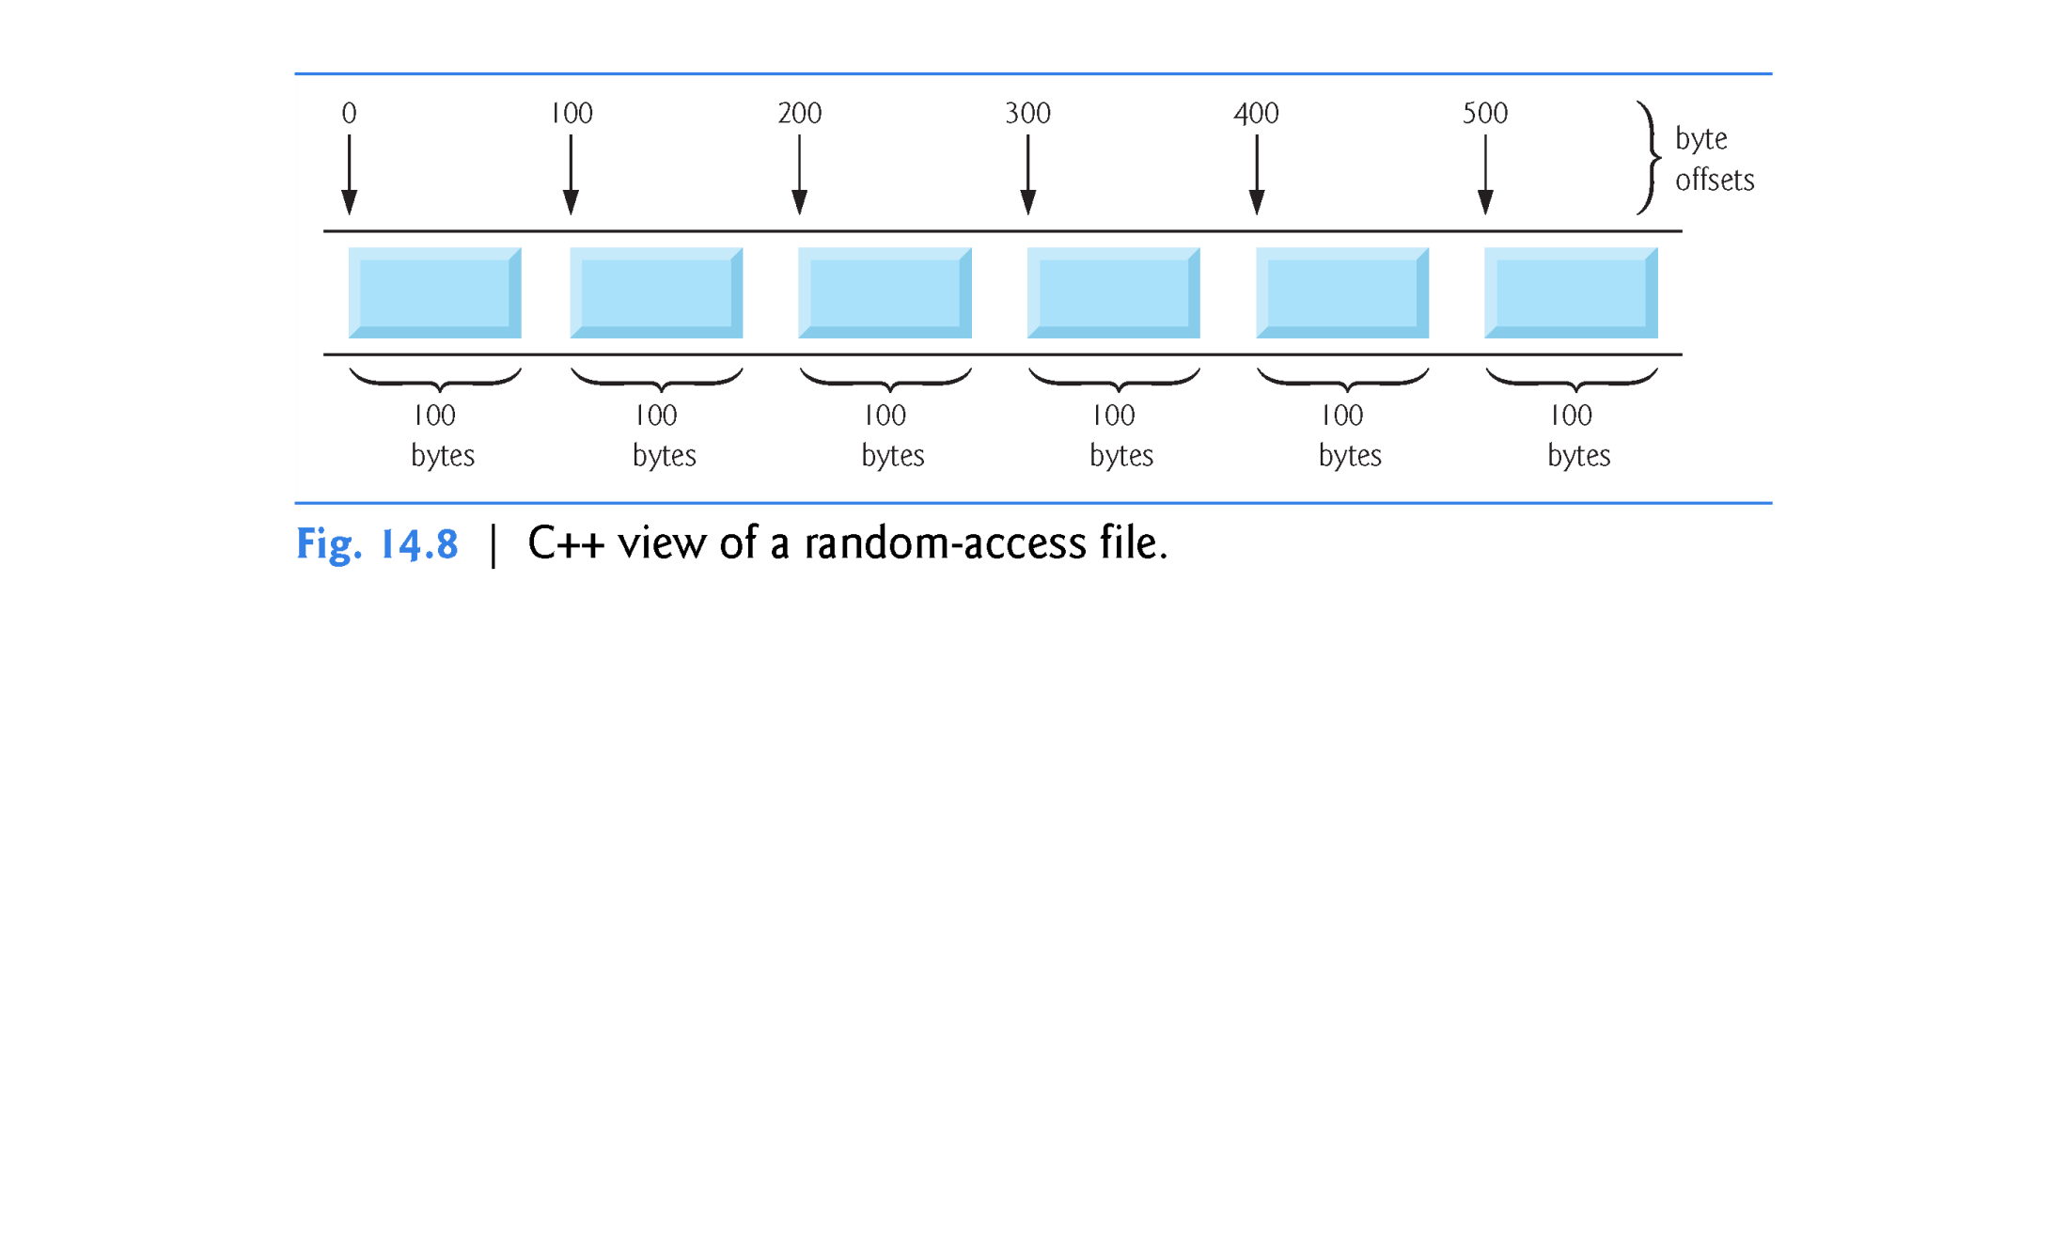

Slide 56
14.6 Random-Access Files
Data can be inserted into a random-access file without destroying other data in the file.
Data stored previously also can be updated or deleted without rewriting the entire file.
In the following sections, we explain how to create a random-access file, enter data into the file, read the data both sequentially and randomly, update the data and delete data that is no longer needed.

Slide 57
14.7 Creating a Random-Access File
The ostream member function write outputs to the specified stream a fixed number of bytes, beginning at a specific location in memory.
When the stream is associated with a file, function write writes the data at the location in the file specified by the put file-position pointer.
The istream member function read inputs a fixed number of bytes from the specified stream to an area in memory beginning at a specified address.
If the stream is associated with a file, function read inputs bytes at the location in the file specified by the get file-position pointer.

Slide 58
14.7 Creating a Random-Access File
Writing Bytes with ostream Member Function write
Outputting a four-byte integer as text could print as few digits as one or as many as 11 (10 digits plus a sign, each requiring a single byte of storage)
The following statement always writes the binary version of the integer’s four bytes (on a machine with four-byte integers):
outFile.write( reinterpret_cast < const char * >( &number ), sizeof( number ) );
Function write treats its first argument as a group of bytes by viewing the object in memory as a const char *, which is a pointer to a byte.
Starting from that location, function write outputs the number of bytes specified by its second argument - an integer of type size_t.
istream function read can be used to read the four bytes back into an integer variable.

Slide 59
14.7 Creating a Random-Access File
Converting Between Pointer Types with the reinterpret_cast Operator
Most pointers that we pass to function write as the first argument are not of type const char *.
Must convert the pointers to those objects to type const char *; otherwise, the compiler will not compile calls to function write.
C++ provides the reinterpret_cast operator for cases like this in which a pointer of one type must be cast to an unrelated pointer type.
Without a reinterpret_cast, the write statement that outputs the integer number will not compile because the compiler does not allow a pointer of type int * (the type returned by the expression &number) to be passed to a function that expects an argument of type const char *—as far as the compiler is concerned, these types are inconsistent.
A reinterpret_cast is performed at compile time and does not change the value of the object to which its operand points.

Slide 60
14.7 Creating a Random-Access File
In Fig. 14.11, we use reinterpret_cast to convert a ClientData pointer to a const char *, which reinterprets a ClientData object as bytes to be output to a file.
Random-access file-processing programs typically write one object of a class at a time, as we show in the following examples.

Slide 61
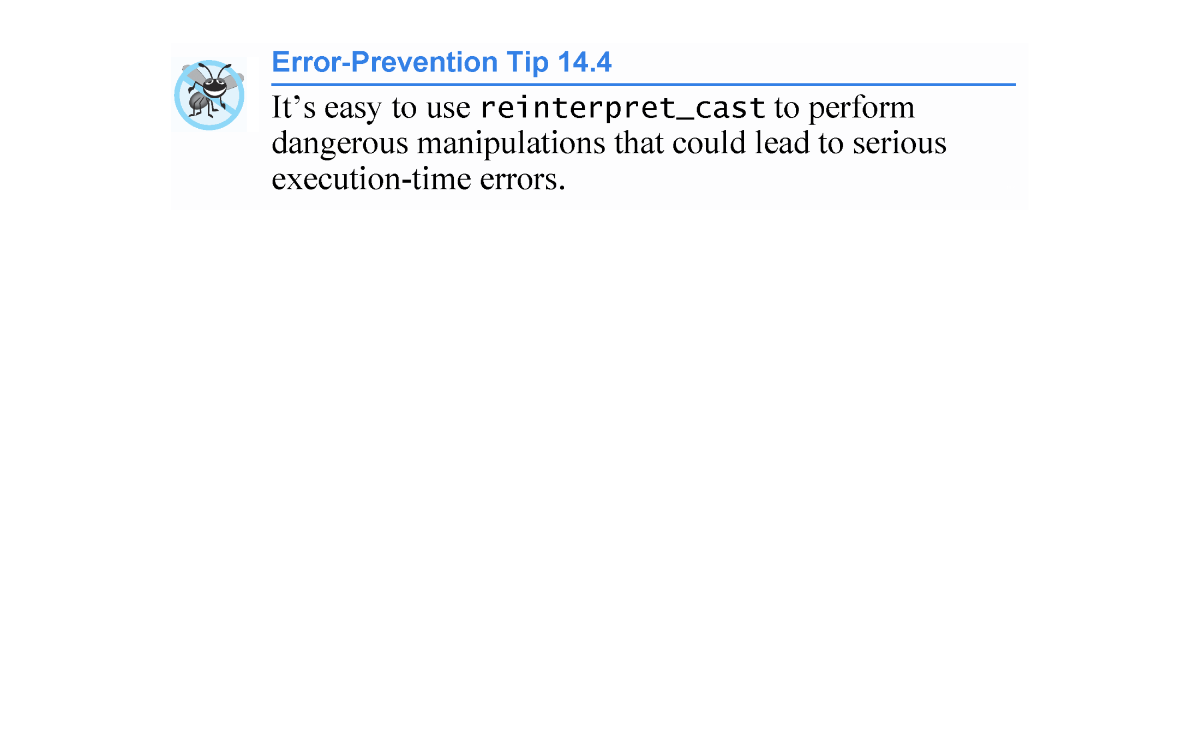

Slide 62
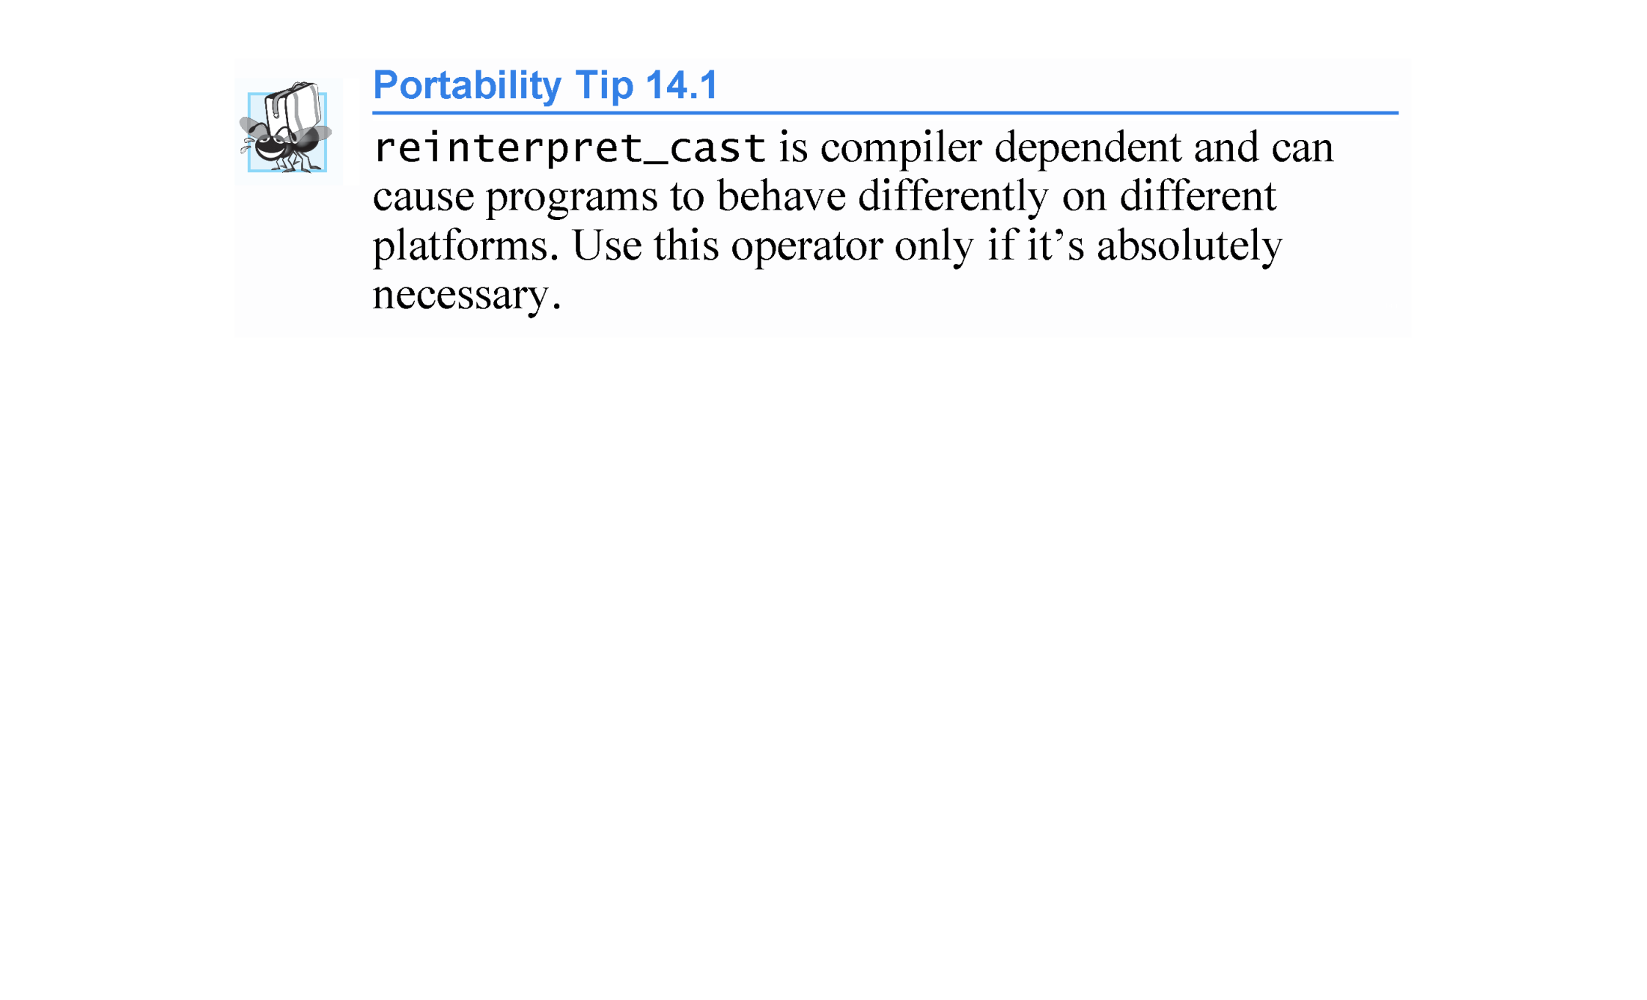

Slide 63
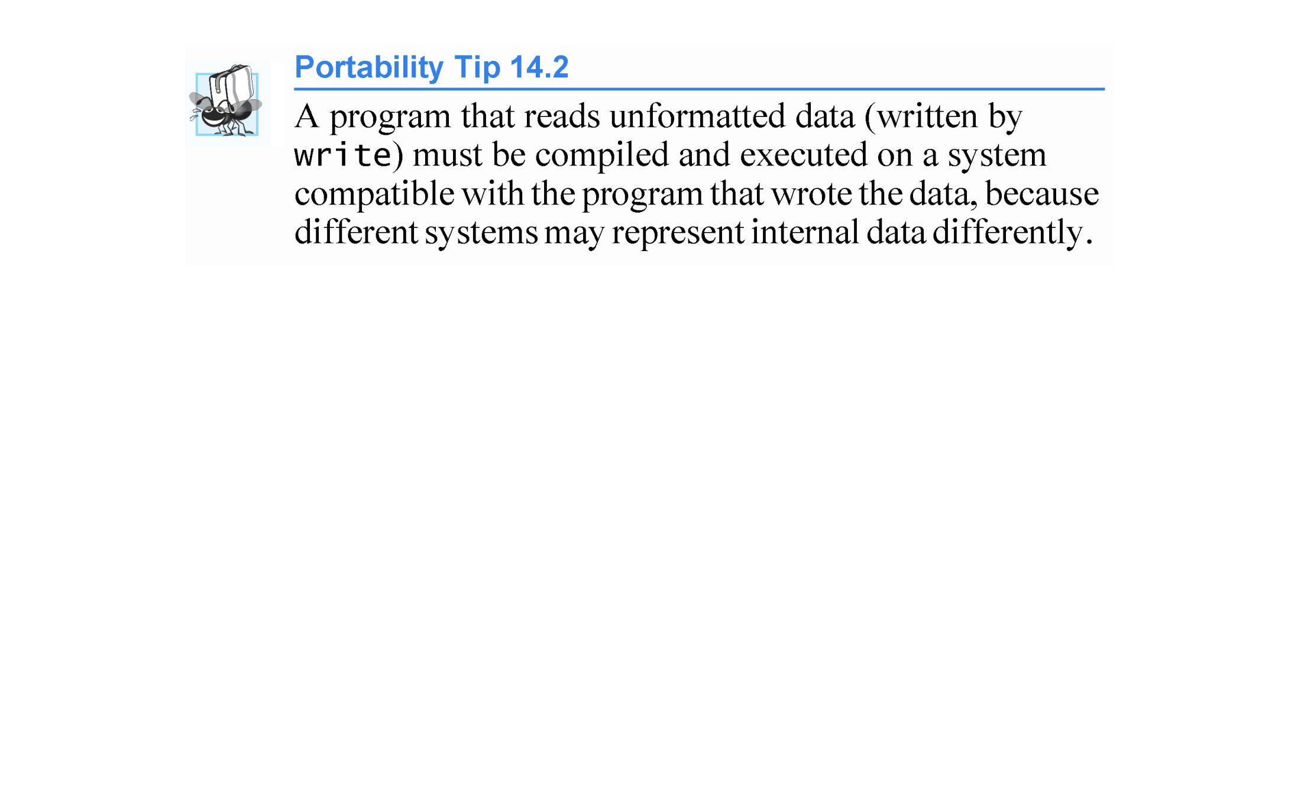

Slide 64
14.7 Creating a Random-Access File
Credit Processing Program
Consider the following problem statement:
Create a credit-processing program capable of storing at most 100 fixed-length records for a company that can have up to 100 customers. Each record should consist of an account number that acts as the record key, a last name, a first name and a balance. The program should be able to update an account, insert a new account, delete an account and insert all the account records into a formatted text file for printing.
The next few sections create this credit-processing program.

Slide 65
14.7 Creating a Random-Access File
Figure 14.11 illustrates opening a random-access file, defining the record format using an object of class ClientData (Figs. 14.9–14.10) and writing data to the disk in binary format.
This program initializes all 100 records of the file credit.dat with empty objects, using function write.
Each empty object contains the account number 0, empty last and first name strings and the balance 0.0.
Each record is initialized with the space in which the account data will be stored.

Slide 66
14.7 Creating a Random-Access File
Objects of class string do not have uniform size, rather they use dynamically allocated memory to accommodate strings of various lengths.
We must maintain fixed-length records, so class ClientData stores the client’s first and last name in fixed-length char arrays (declared in Fig. 14.9, lines 32–33).
Member functions setLastName (Fig. 14.10, lines 35–42) and setFirstName (Fig. 14.10, lines 51–58) each copy the characters of a string object into the corresponding char array.

Slide 67
14.7 Creating a Random-Access File
Consider function setLastName.
Line 38 invokes string member function size to get the length of lastNameString.
Line 39 ensures that length is fewer than 15 characters, then line 40 copies length characters from lastNameString into the char array lastName using string member function copy.
Member function setFirstName performs the same steps for the first name.

Slide 68
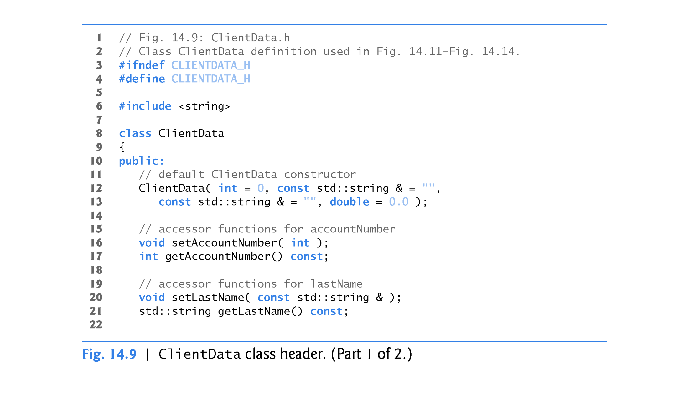

Slide 69
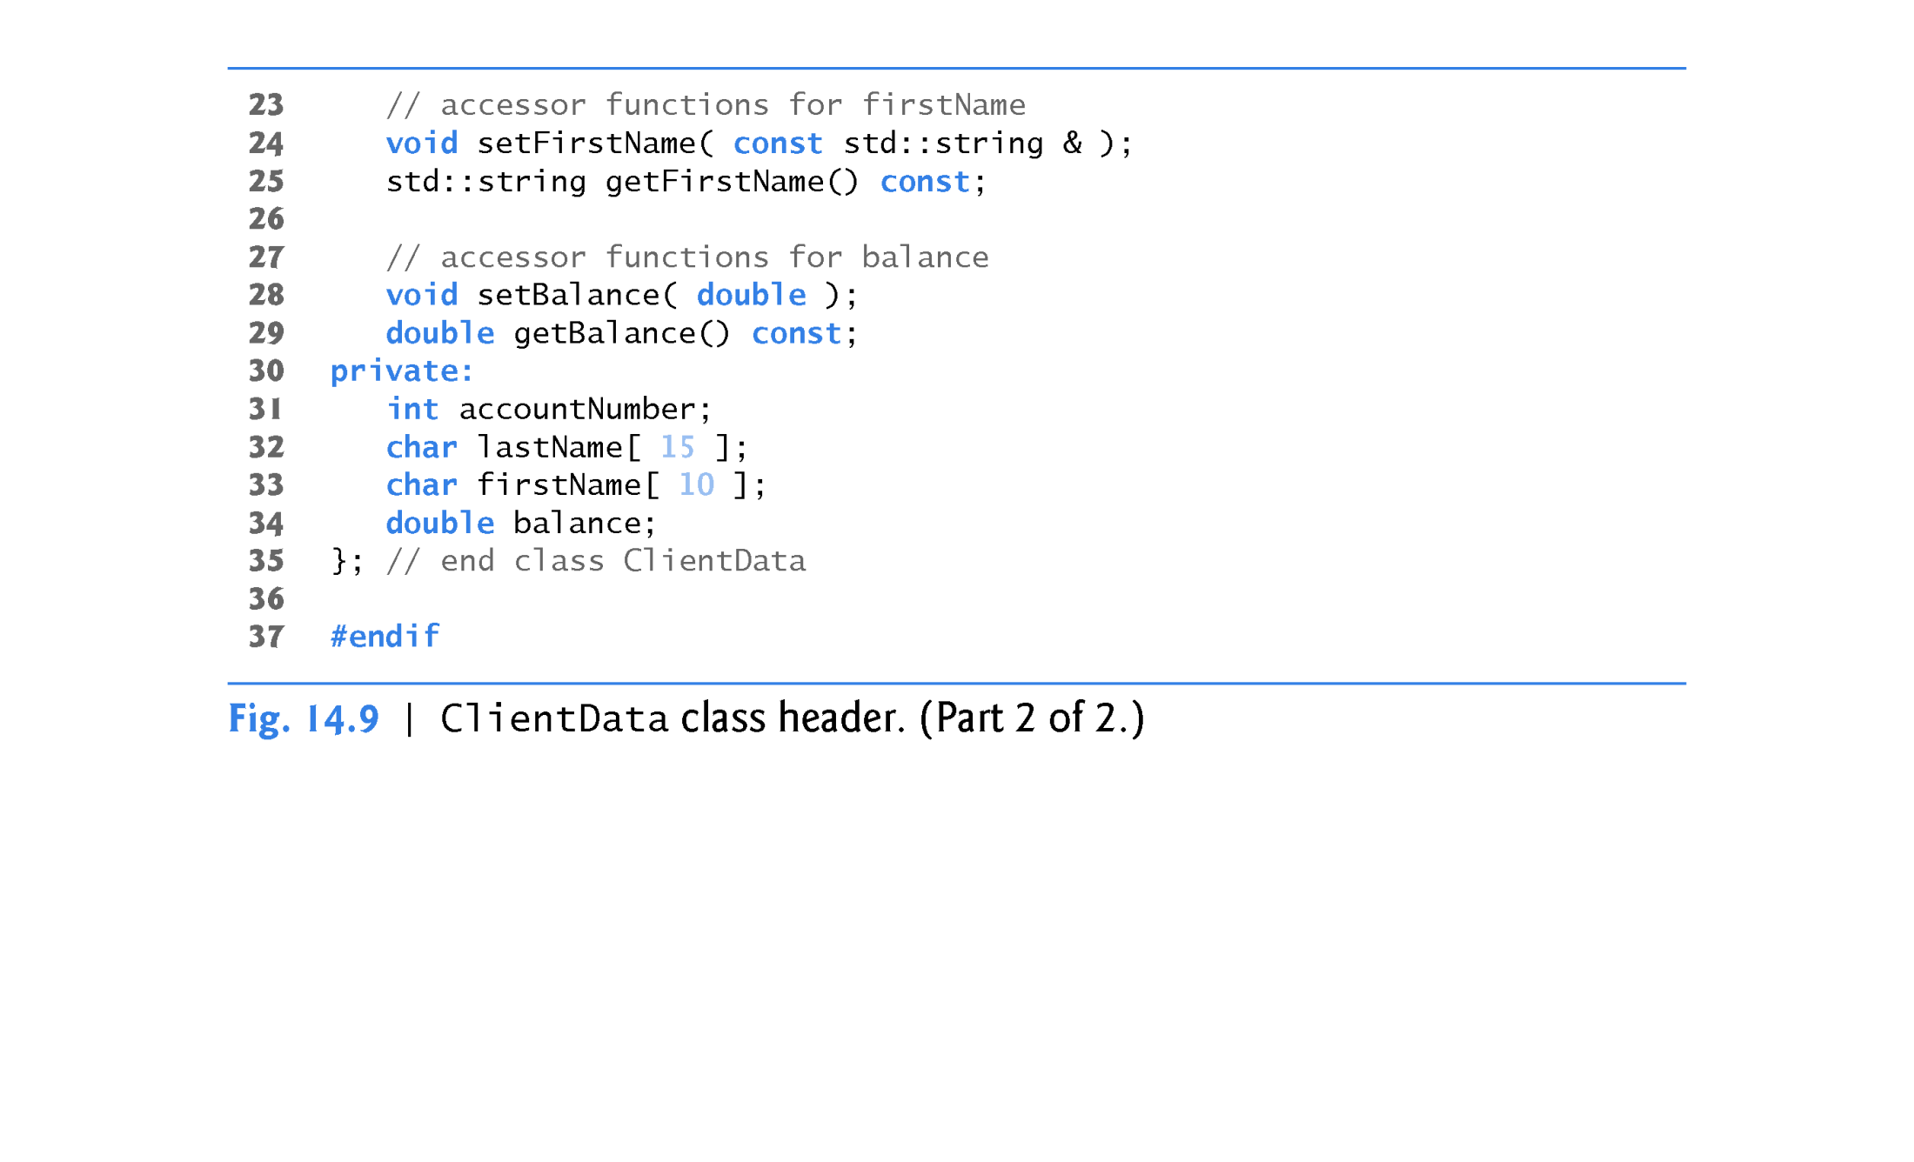

Slide 70
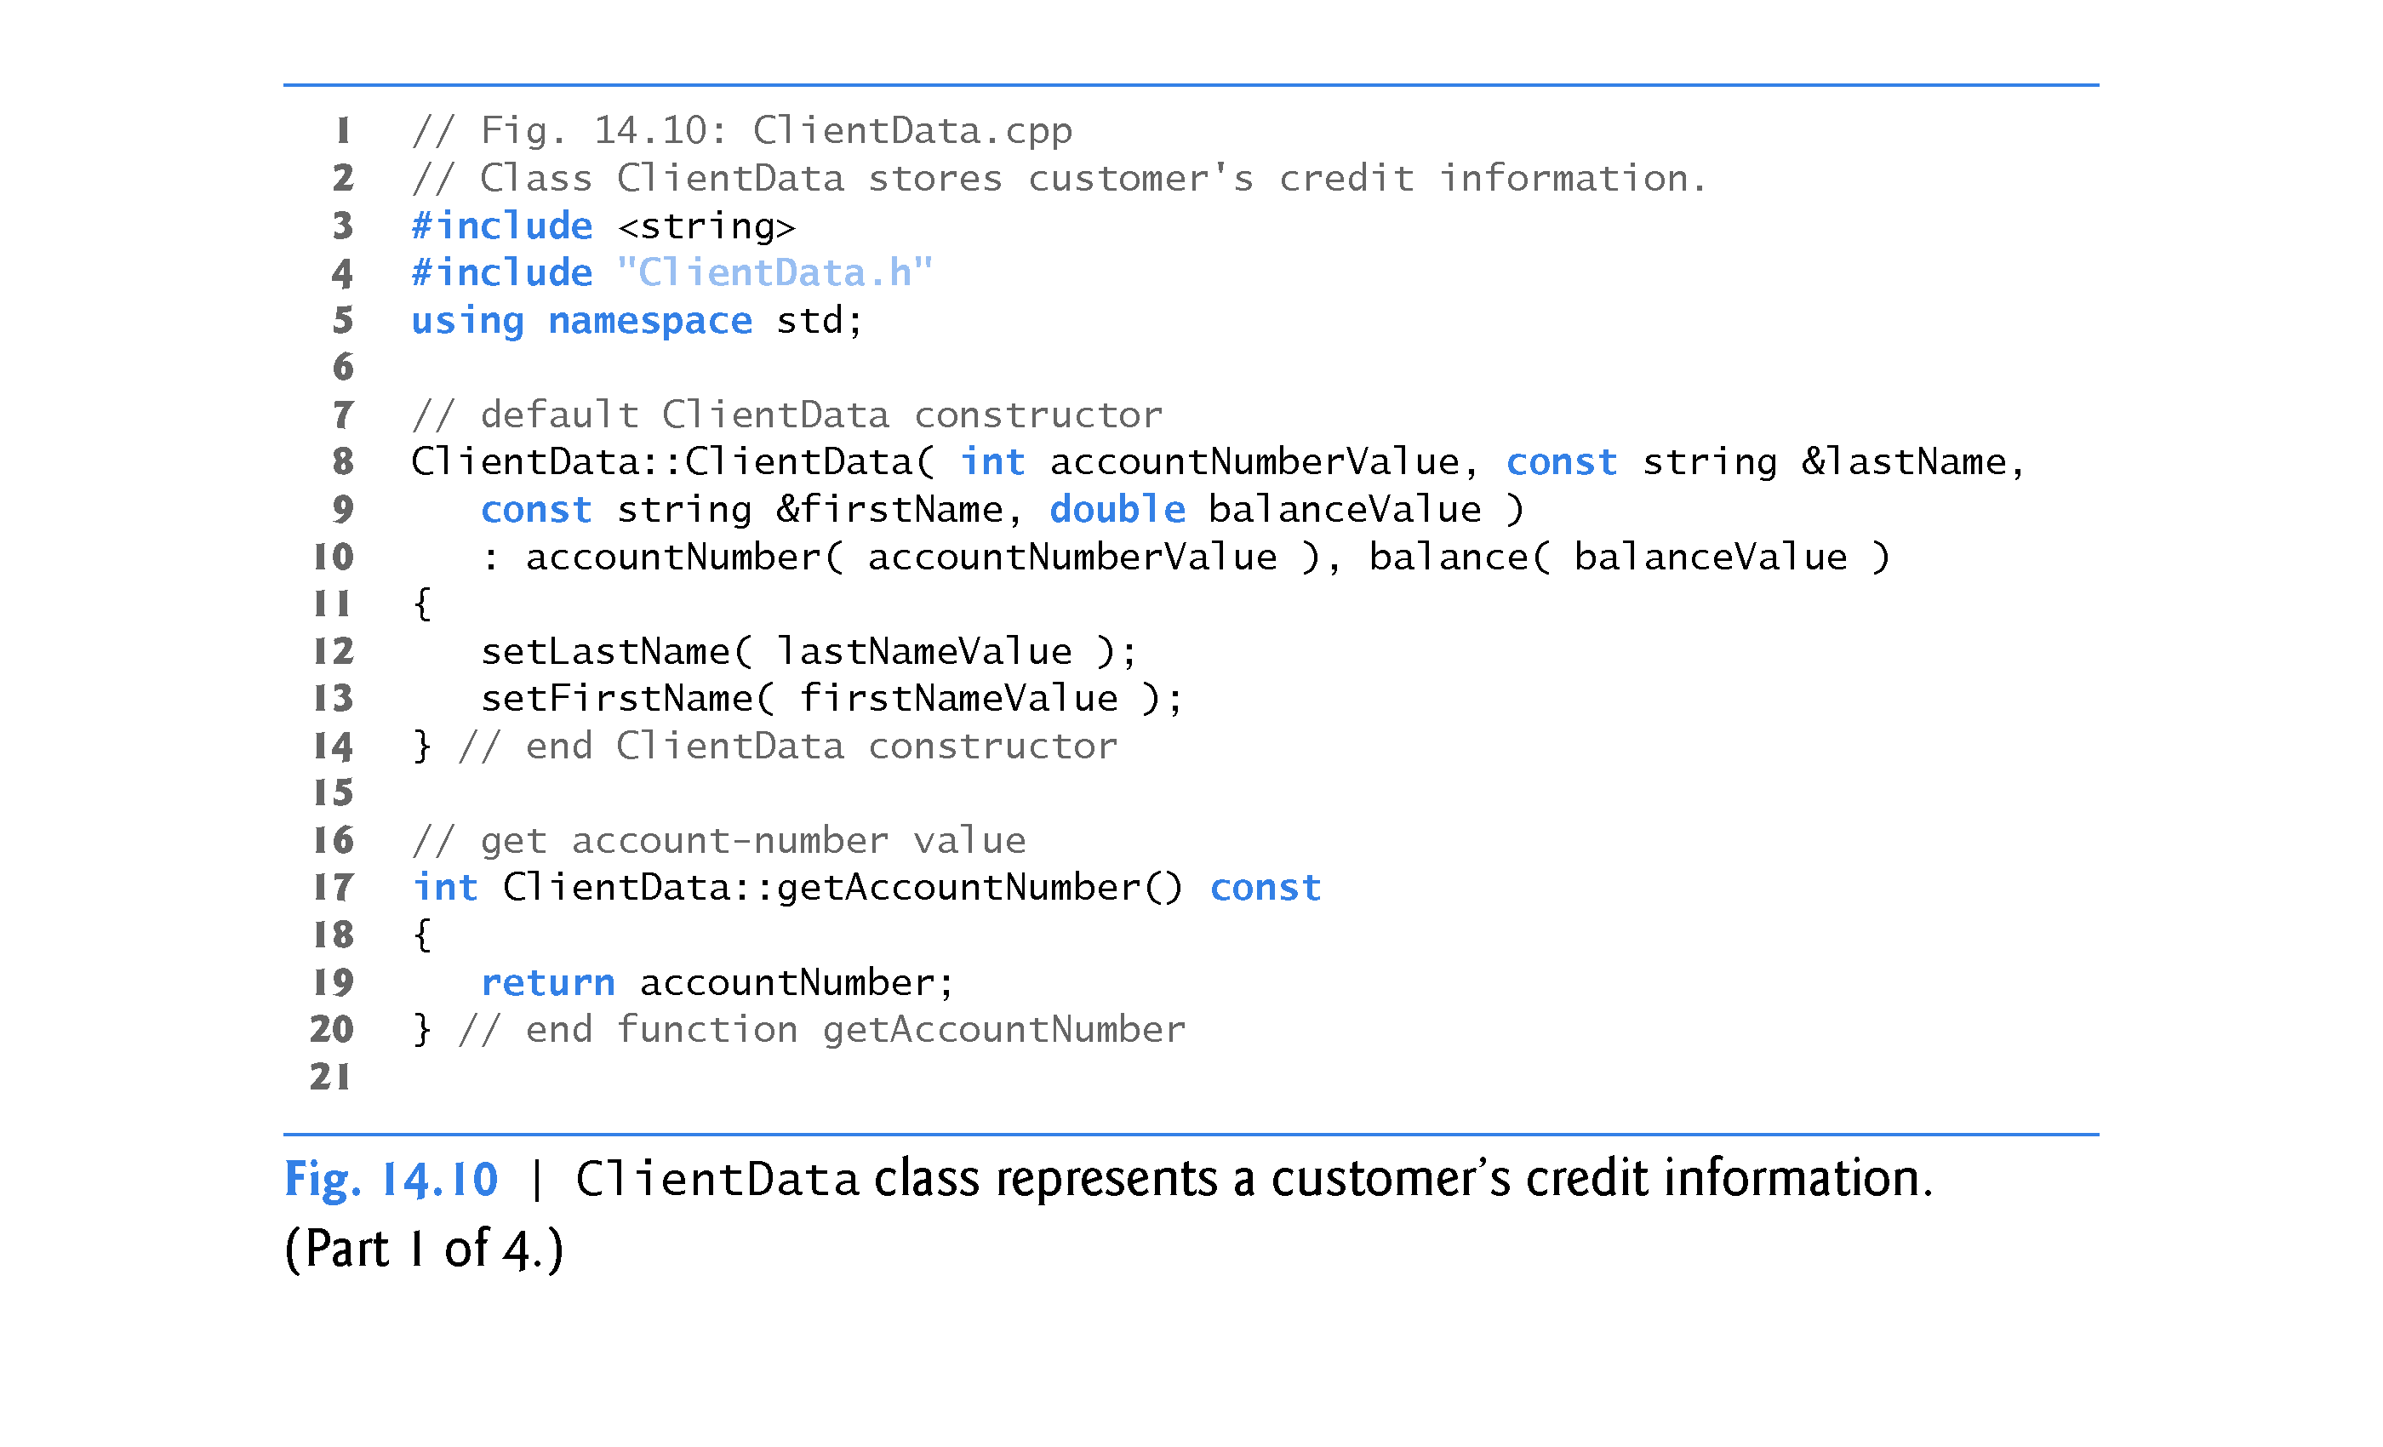

Slide 71
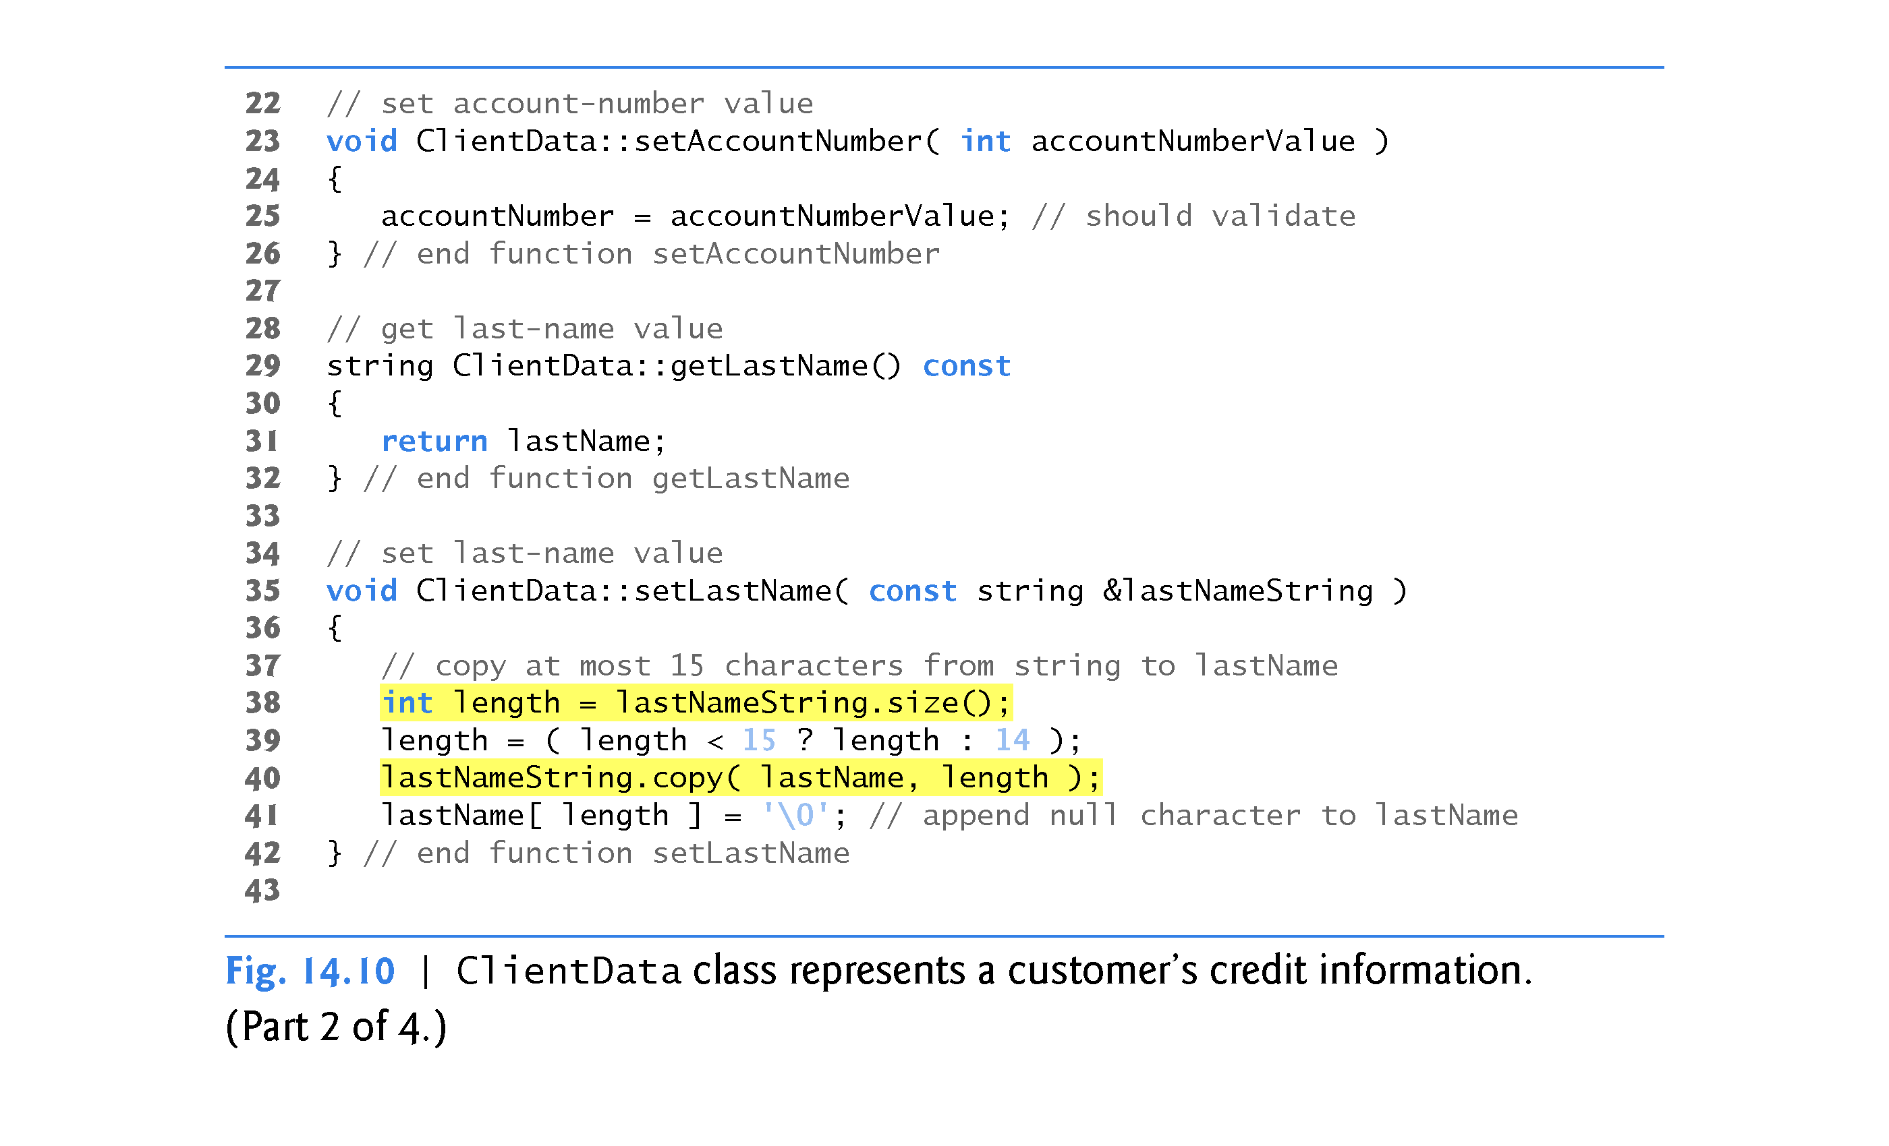

Slide 72
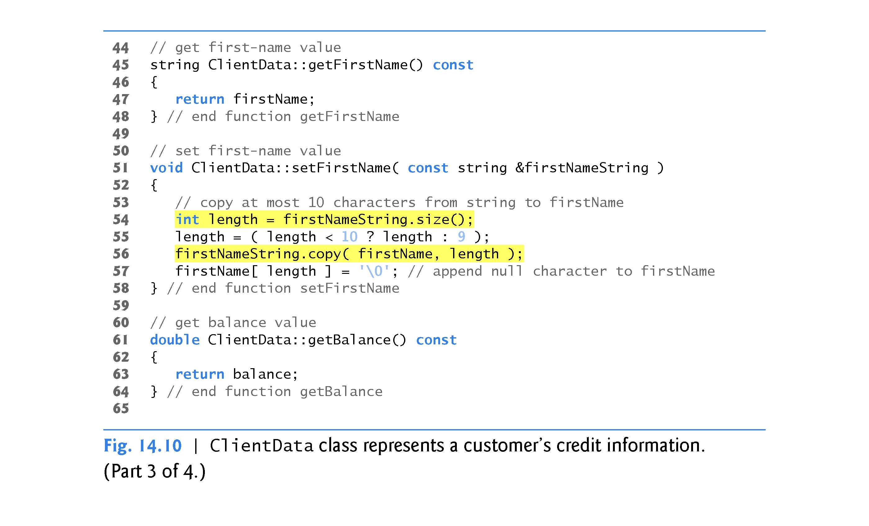

Slide 73
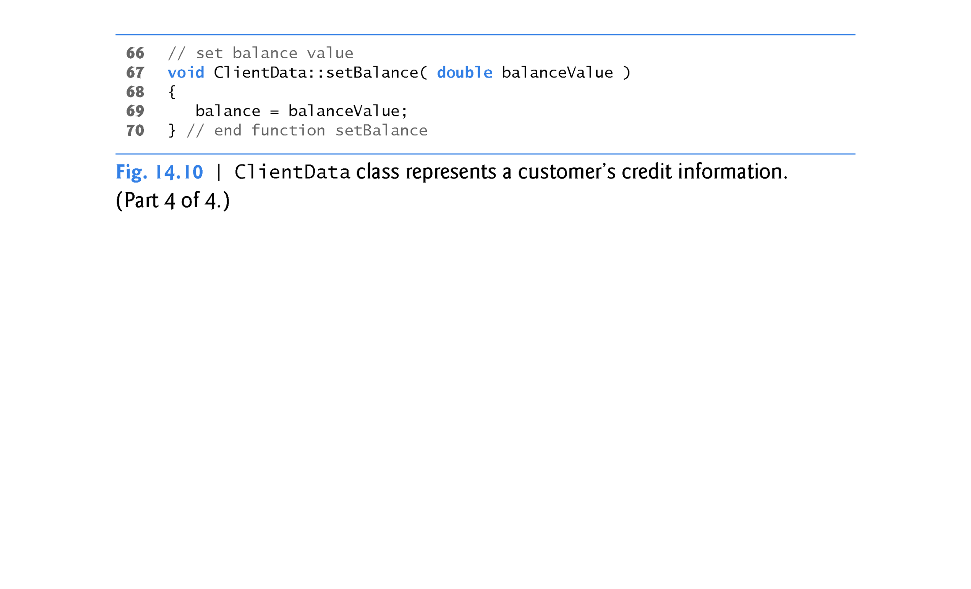

Slide 74
14.7 Creating a Random-Access File
Opening a File for Output in Binary Mode
In Fig. 14.11, line 11 creates an ofstream object for the file credit.dat.
The second argument to the constructor: ios::out | ios::binary indicates that we are opening the file for output in binary mode, which is required if we are to write fixed-length records.
Multiple file-open modes are combined by separating each open mode from the next with the | operator, which is known as the bitwise inclusive OR operator.

Slide 75
14.7 Creating a Random-Access File
Lines 24–25 cause the blankClient (which was constructed with default arguments at line 20) to be written to the credit.dat file associated with ofstream object outCredit.
Operator sizeof returns the size in bytes of the object contained in parentheses (see Chapter 8).

Slide 76
14.7 Creating a Random-Access File (cont.)
The first argument to function write at line 24 must be of type const char *.
However, the data type of &blankClient is Client-Data *.
To convert &blankClient to const char *, line 24 uses the cast operator reinterpret_cast, so the call to write compiles without issuing a compilation error.

Slide 77
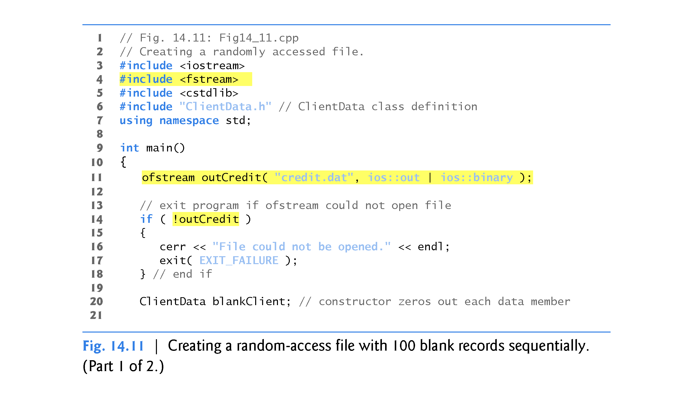

Slide 78
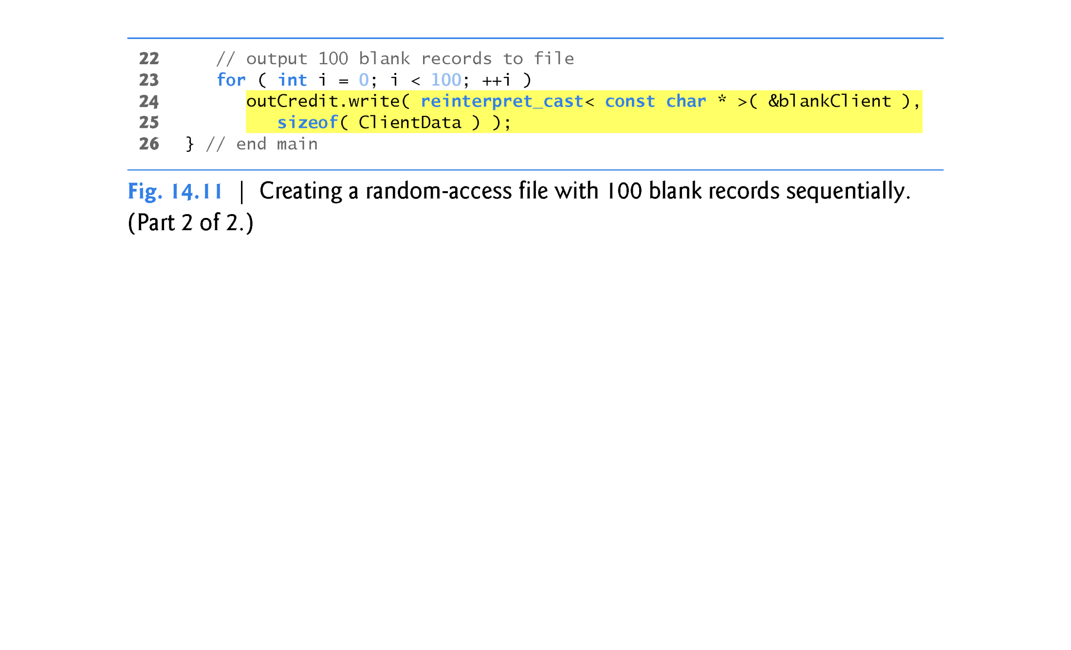

Slide 79
14.8 Writing Data Randomly to a Random Access File
Figure 14.12 writes data to the file credit.dat and uses the combination of fstream functions seekp and write to store data at exact locations in the file.
Function seekp sets the “put” file-position pointer to a specific position in the file, then write outputs the data.
Line 6 includes the header ClientData.h defined in Fig. 14.9, so the program can use ClientData objects.

Slide 80
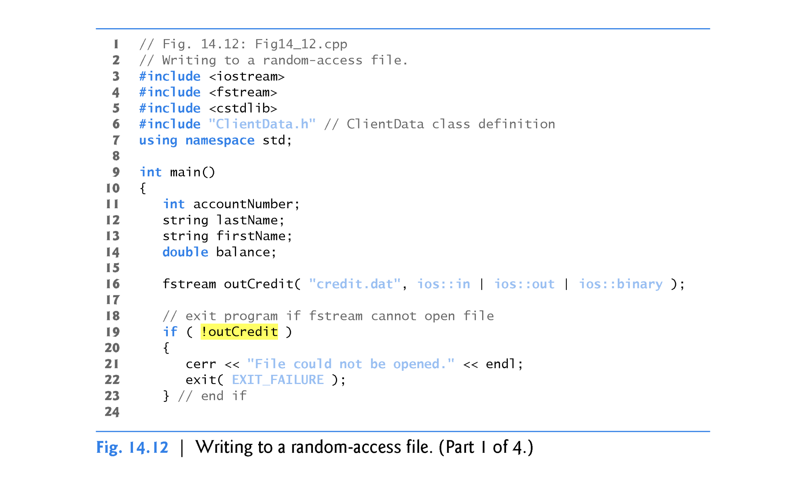

Slide 81
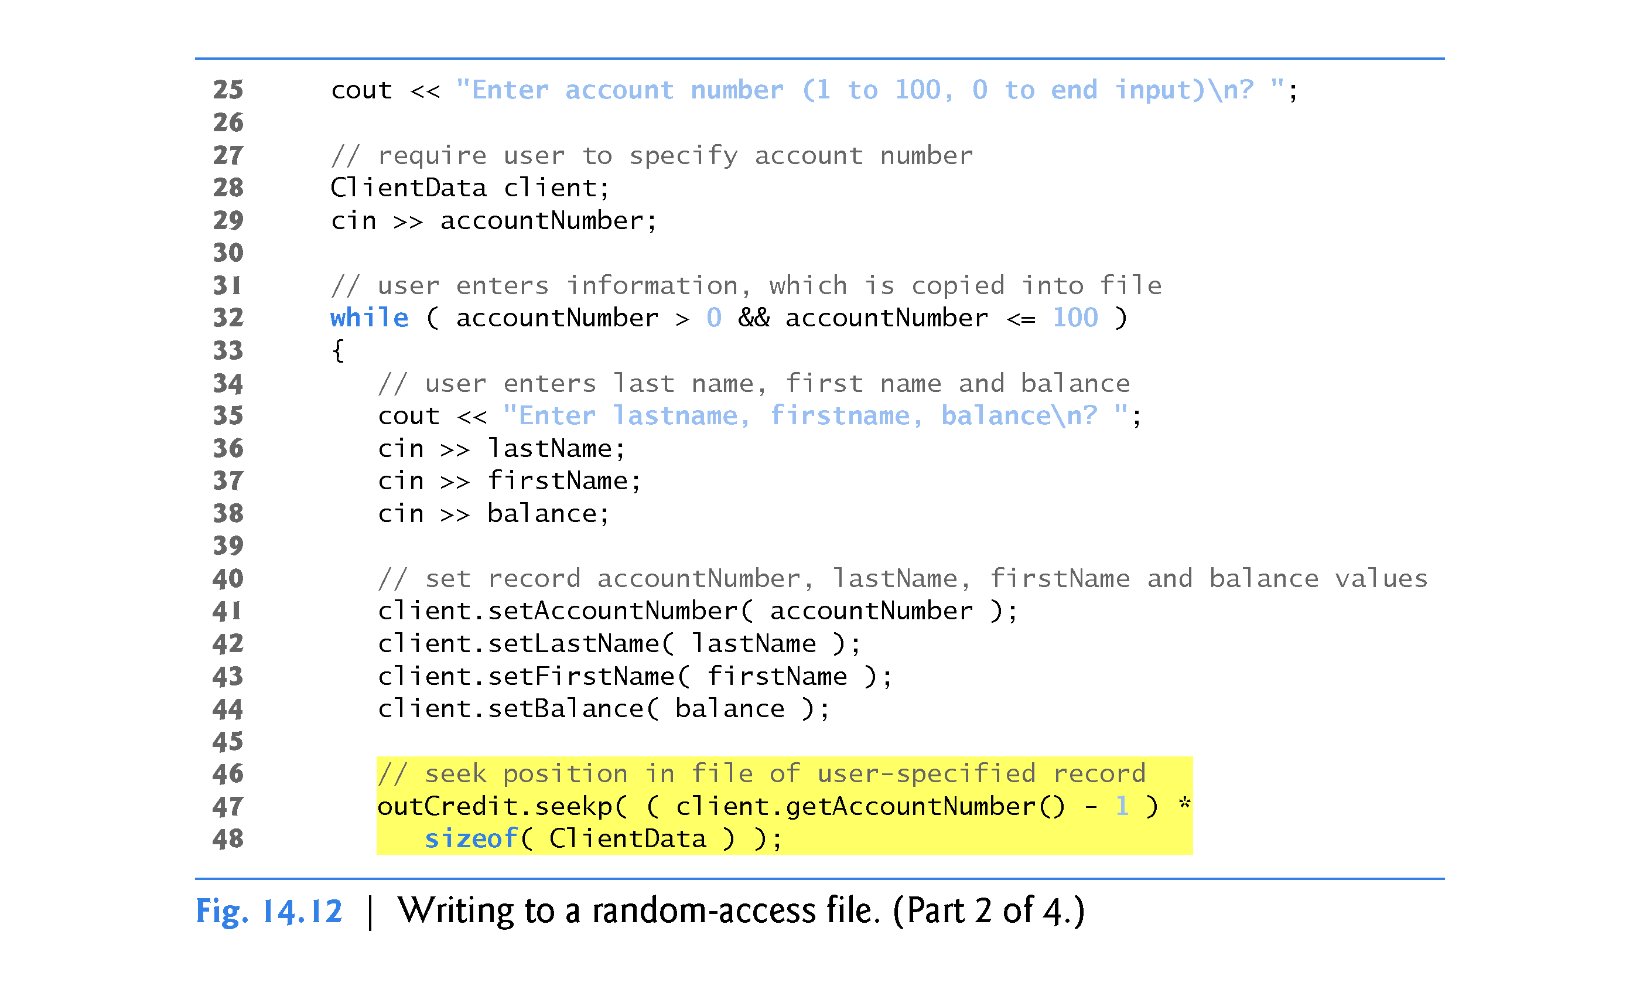

Slide 82
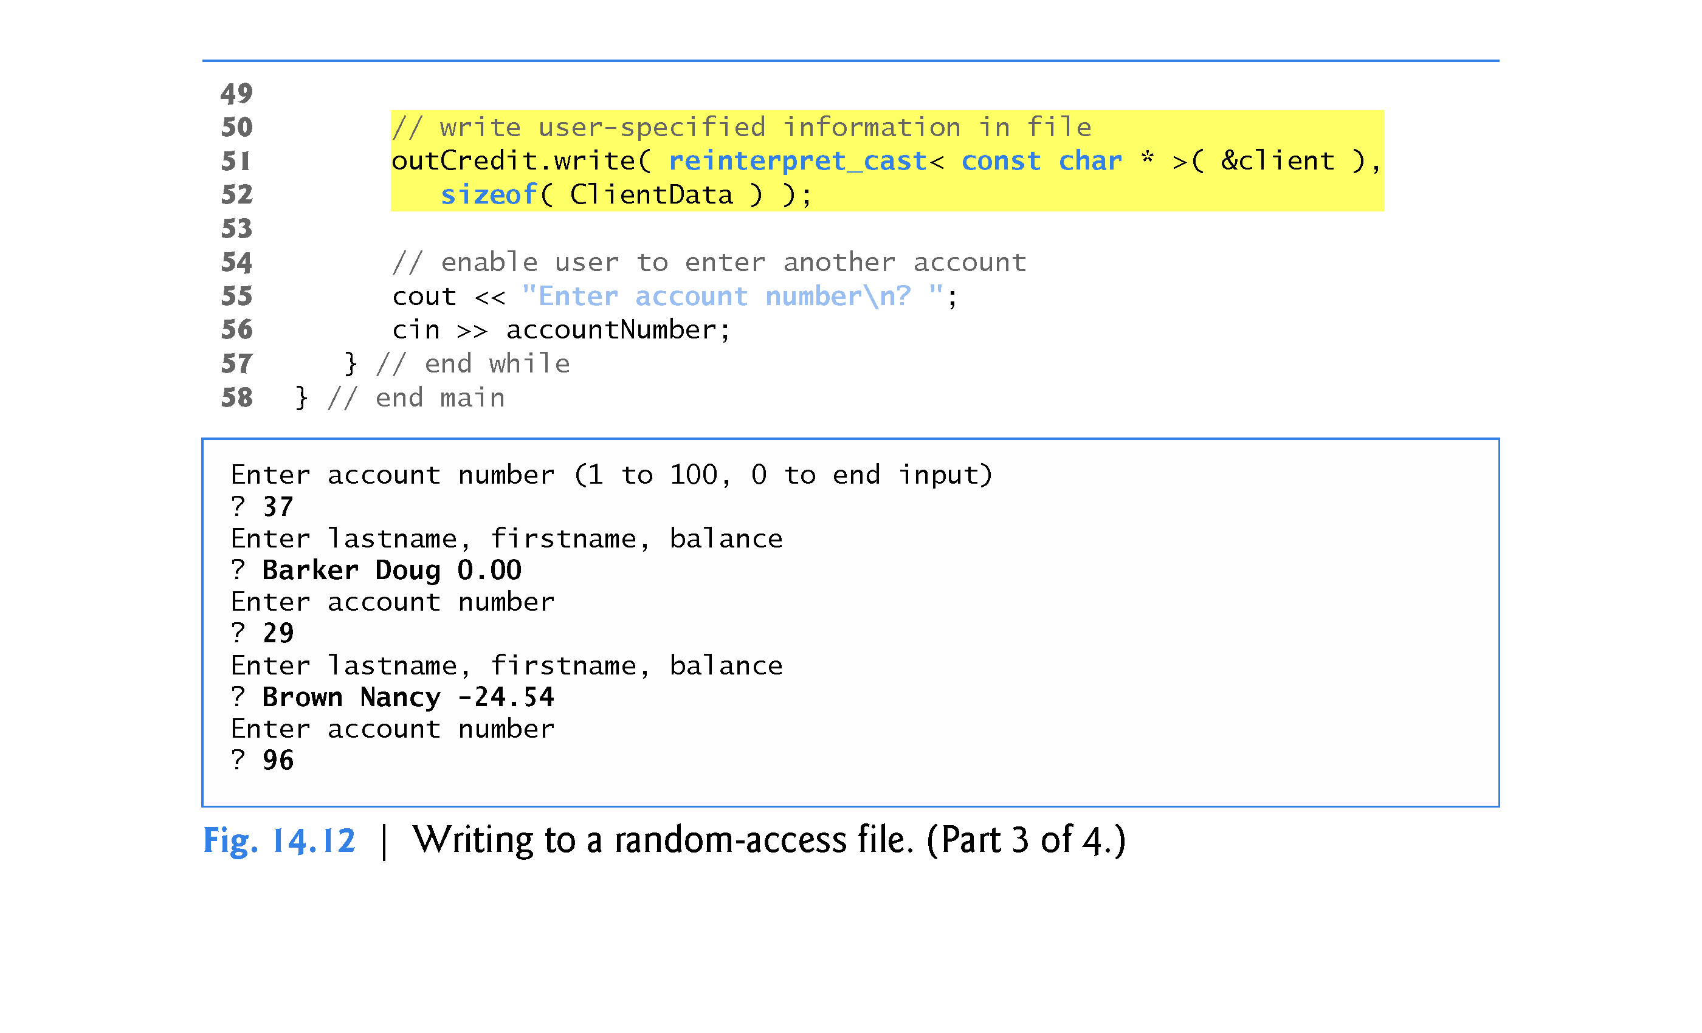

Slide 83
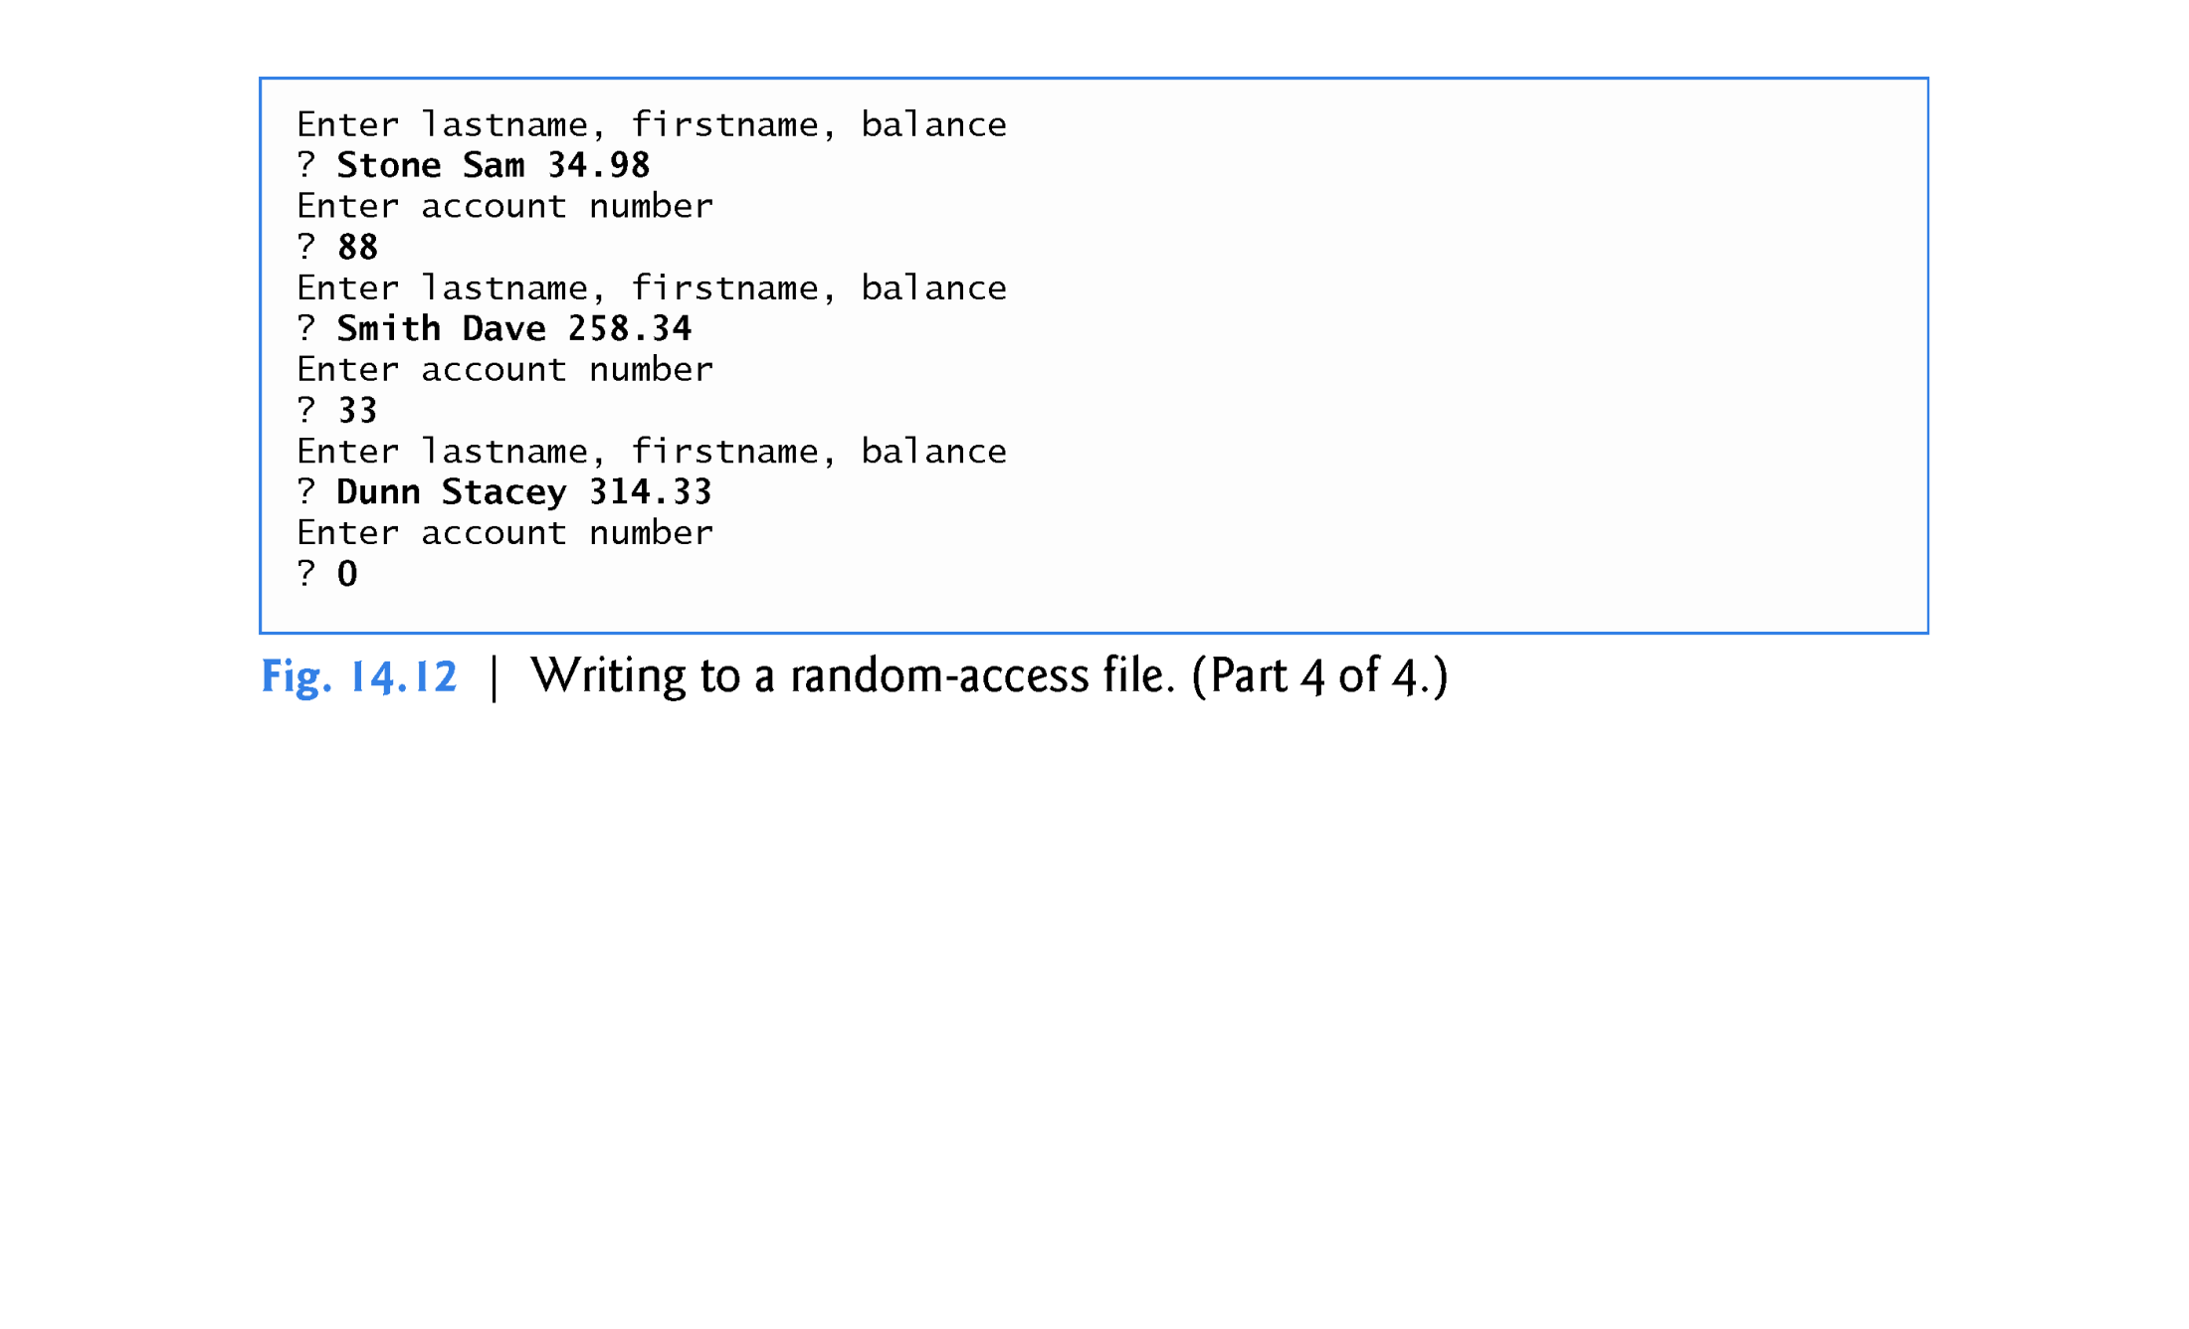

Slide 84
14.8 Writing Data Randomly to a Random-Access File
Opening a File for Input and Output in Binary Mode
Line 16 uses the fstream object outCredit to open the existing credit.dat file.
The file is opened for input and output in binary mode by combining the file-open modes ios::in, ios::out and ios::binary.
Opening the existing credit.dat file in this manner ensures that this program can manipulate the records written to the file by the program of Fig. 14.11, rather than creating the file from scratch.

Slide 85
14.8 Writing Data Randomly to a Random-Access File
Positioning the File Position Pointer
Lines 47–48 position the put file-position pointer for object outCredit to the byte location calculated by
( client.getAccountNumber() - 1 ) * sizeof( ClientData )
Because the account number is between 1 and 100, 1 is subtracted from the account number when calculating the byte location of the record.
Thus, for record 1, the file-position pointer is set to byte 0 of the file.

Slide 86
14.9 Reading from a Random Access File Sequentially
In this section, we develop a program that reads a file sequentially and prints only those records that contain data.
The istream function read inputs a specified number of bytes from the current position in the specified stream into an object.
For example, lines 31–32 from Fig. 14.13 read the number of bytes specified by sizeof(ClientData) from the file associated with ifstream object inCredit and store the data in the client record.
Function read requires a first argument of type char *.
Since &client is of type ClientData *, &client must be cast to char * using the cast operator reinterpret_cast.

Slide 87
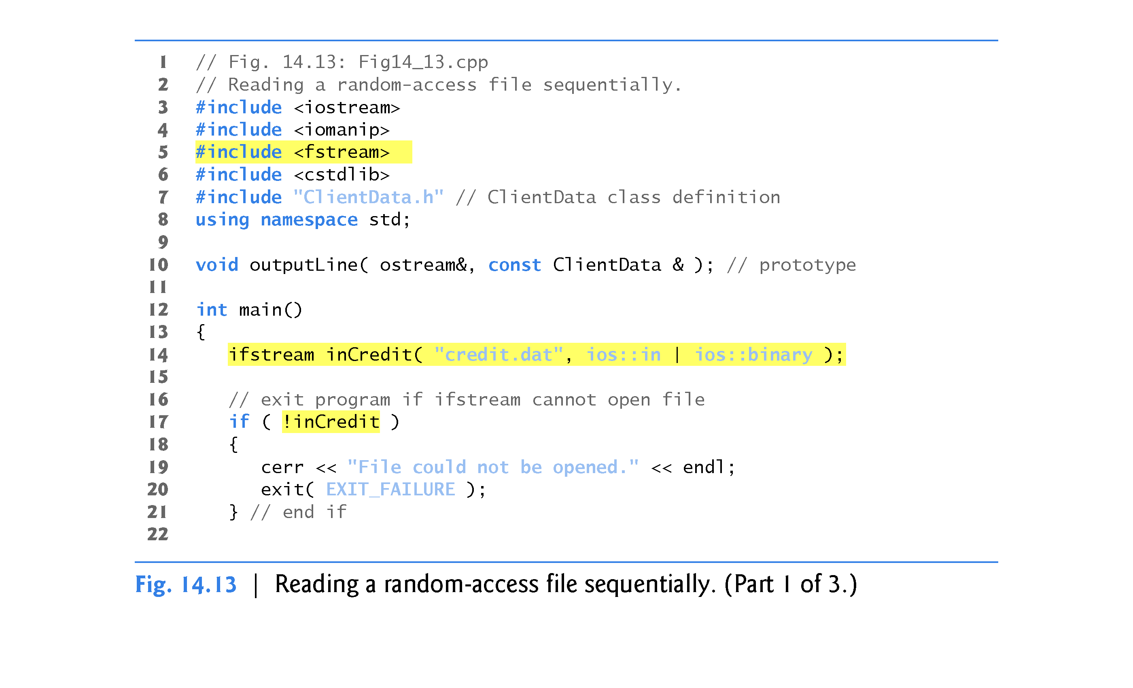

Slide 88
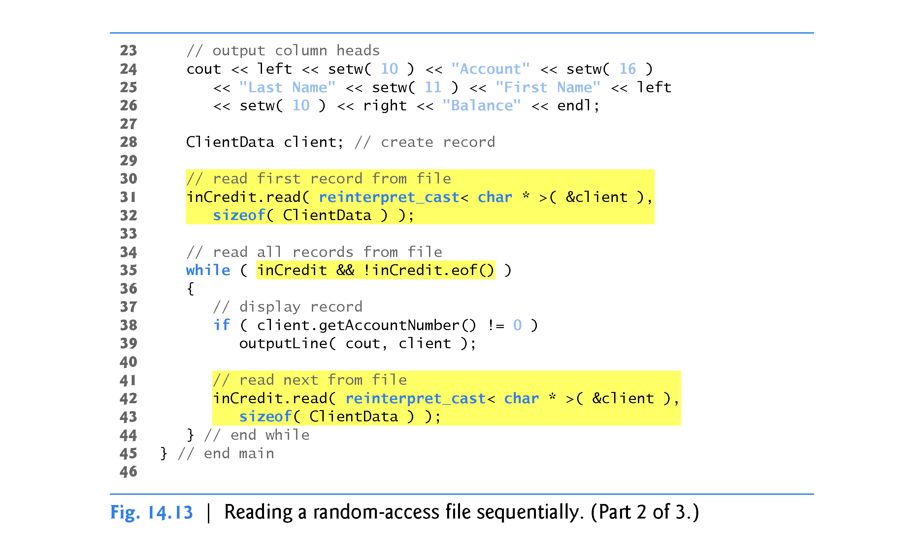

Slide 89
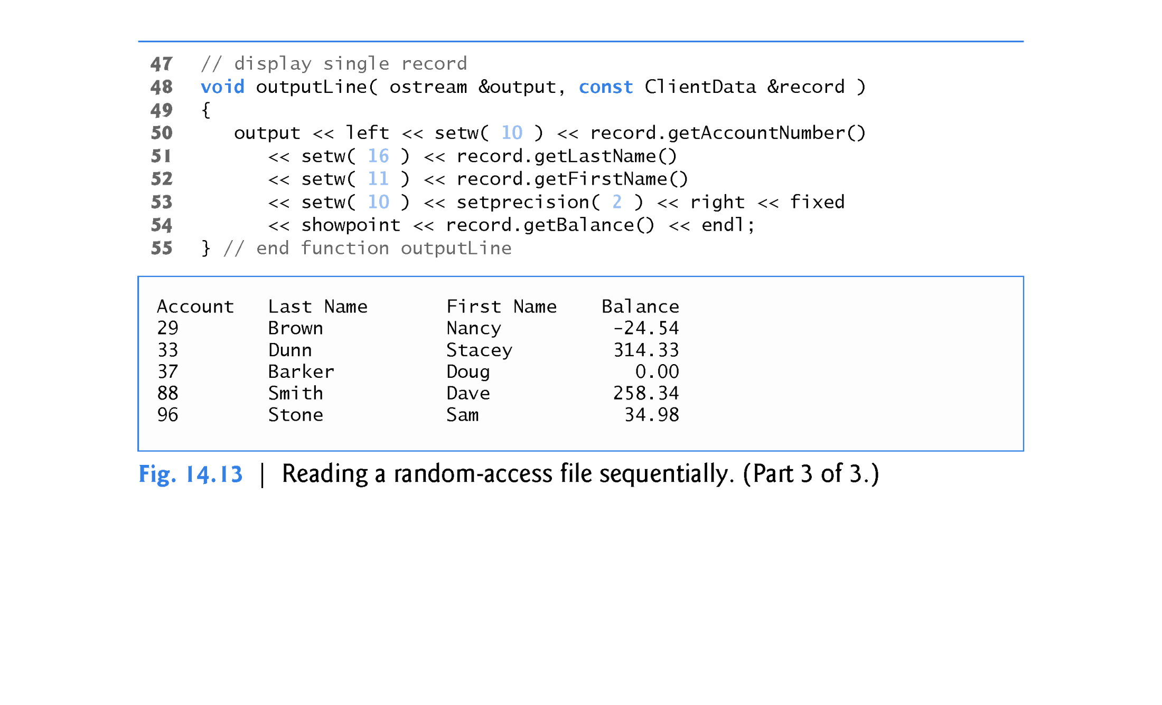

Slide 90
14.9 Reading from a Random Access File Sequentially
Figure 14.13 reads every record in the credit.dat file sequentially, checks each record to determine whether it contains data, and displays formatted outputs for records containing data.
The condition in line 35 uses the ios member function eof to determine when the end of file is reached and causes execution of the while statement to terminate.
Also, if an error occurs when reading from the file, the loop terminates, because inCredit evaluates to false.
The data input from the file is output by function outputLine (lines 48–55), which takes two arguments - an ostream object and a clientData structure to be output.
The ostream parameter type is interesting, because any ostream object (such as cout) or any object of a derived class of ostream (such as an object of type ofstream) can be supplied as the argument.

Slide 91
14.9 Reading from a Random Access File Sequentially
If you examine the output window, you’ll notice that the records are listed in sorted order (by account number).
This is a consequence of how we stored these records in the file, using direct-access techniques.
Sorting using direct-access techniques is relatively fast.
The speed is achieved by making the file large enough to hold every possible record that might be created.
This, of course, means that the file could be occupied sparsely most of the time, resulting in a waste of storage.
This is another example of the space-time trade-off: By using large amounts of space, we can develop a much faster sorting algorithm.
Fortunately, declining storage prices has made this less of an issue.

Slide 92
14.10 Case Study: A Transaction-Processing Program
We now present a substantial transaction-processing program (Fig. 14.14) using a random-access file to achieve “instant-access” processing.
The program updates existing bank accounts, adds new accounts, deletes accounts and stores a formatted listing of all current accounts in a text file.
We assume that the program of Fig. 14.11 has been executed to create the file credit.dat and that the program of Fig. 14.12 has been executed to insert the initial data.

Slide 93
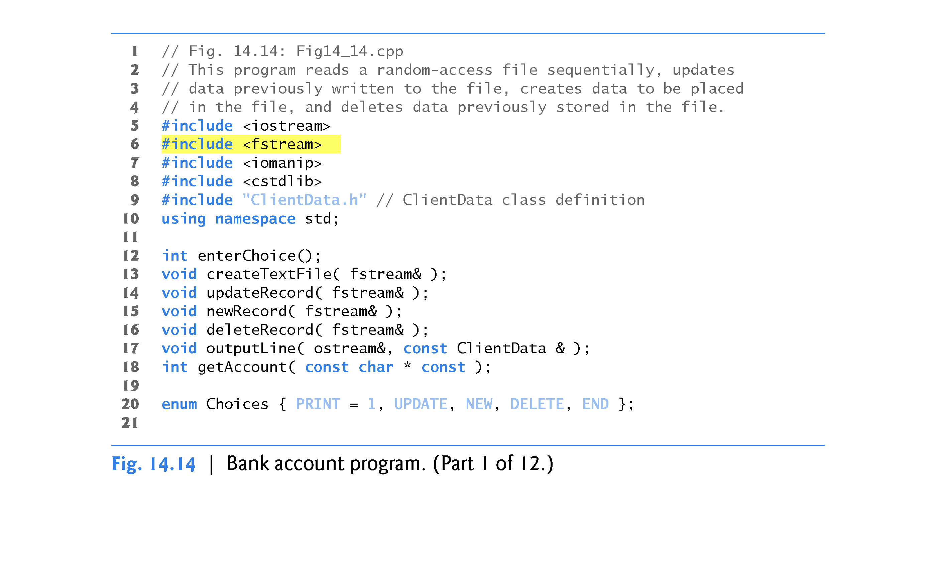

Slide 94
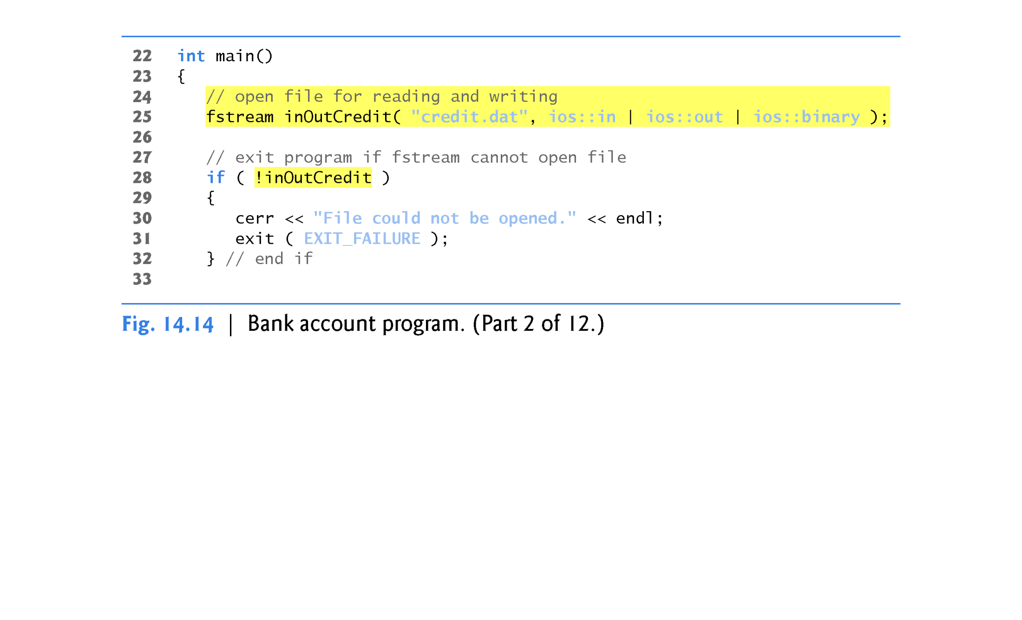

Slide 95
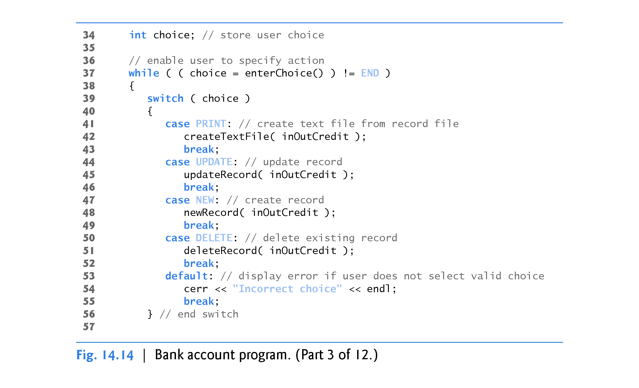

Slide 96
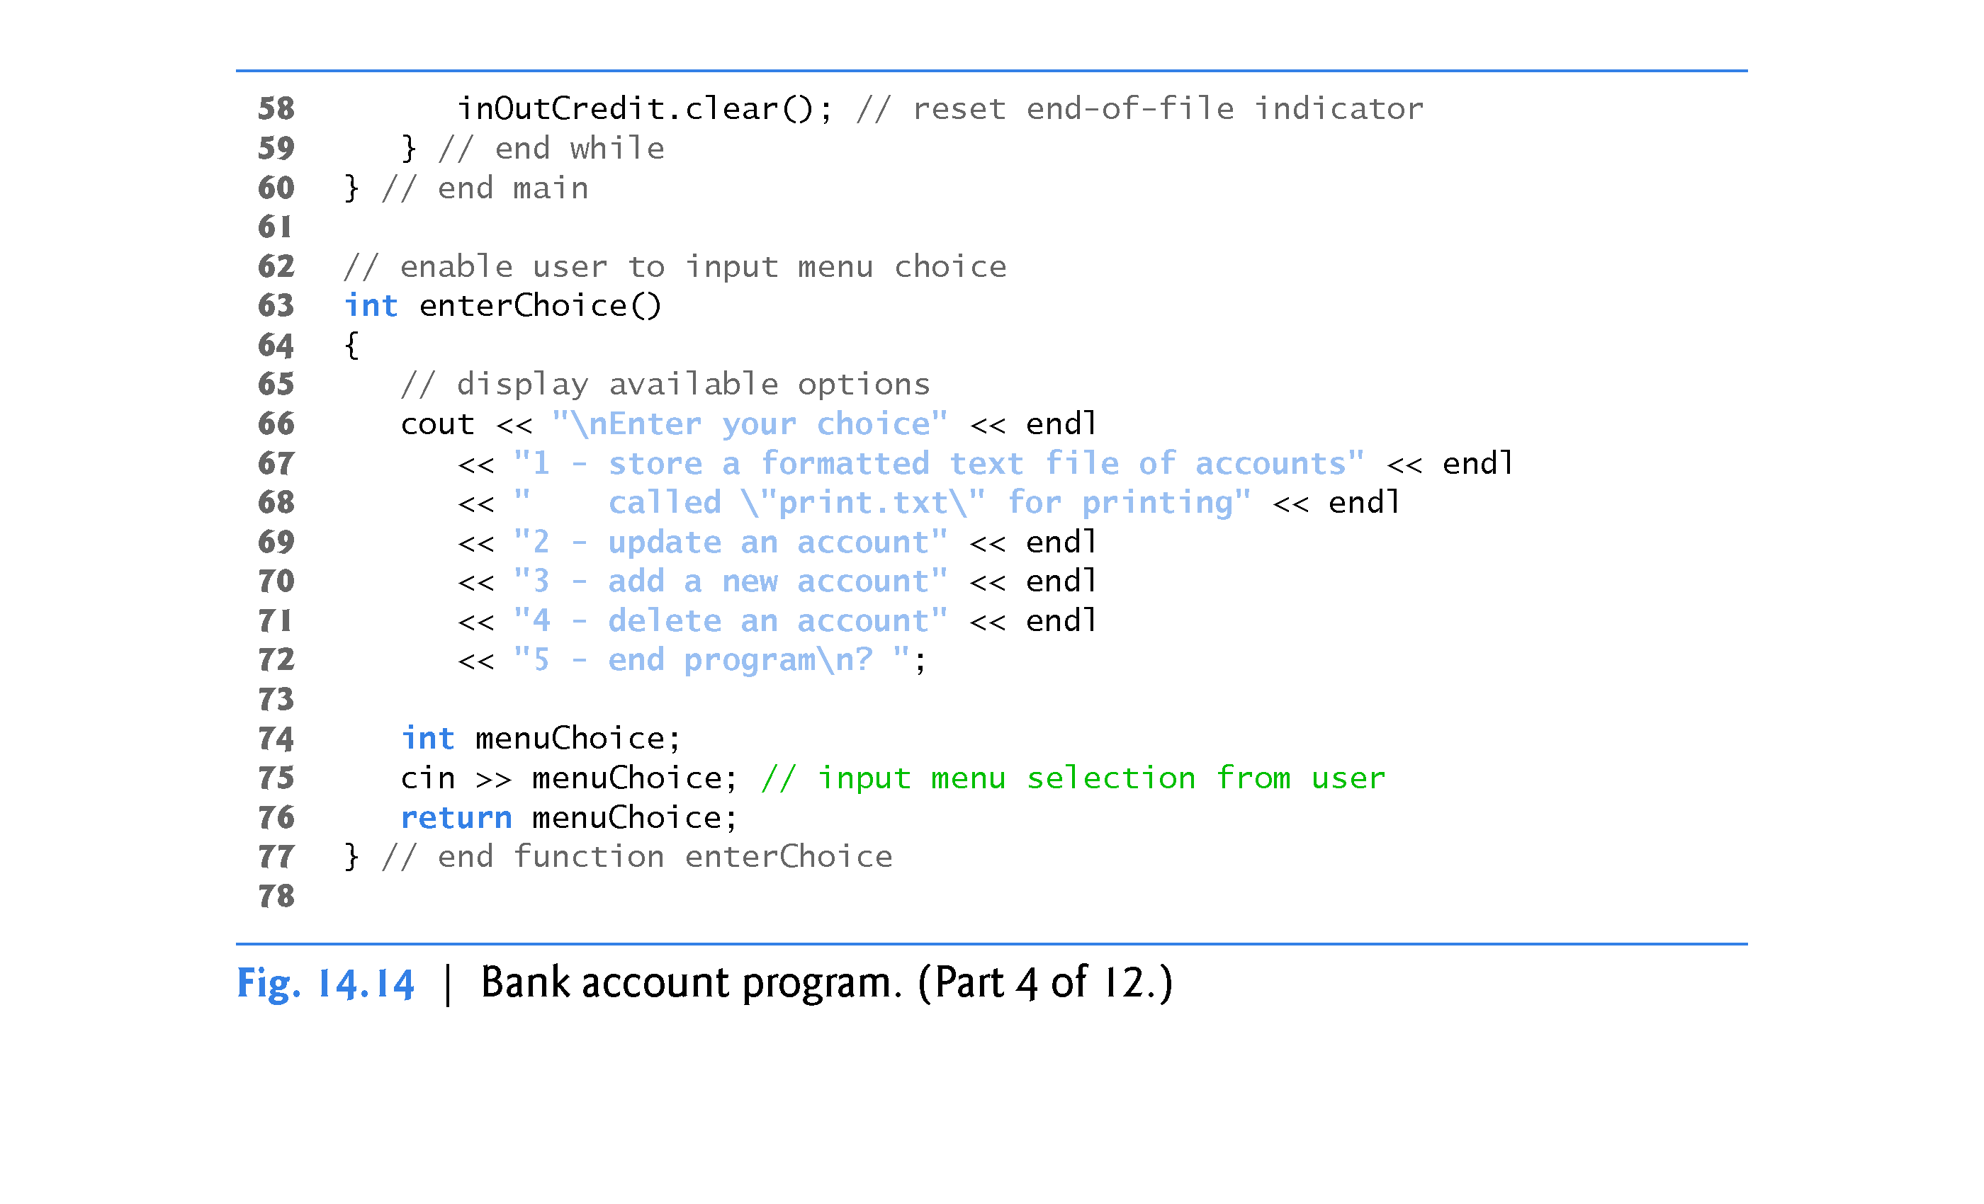

Slide 97
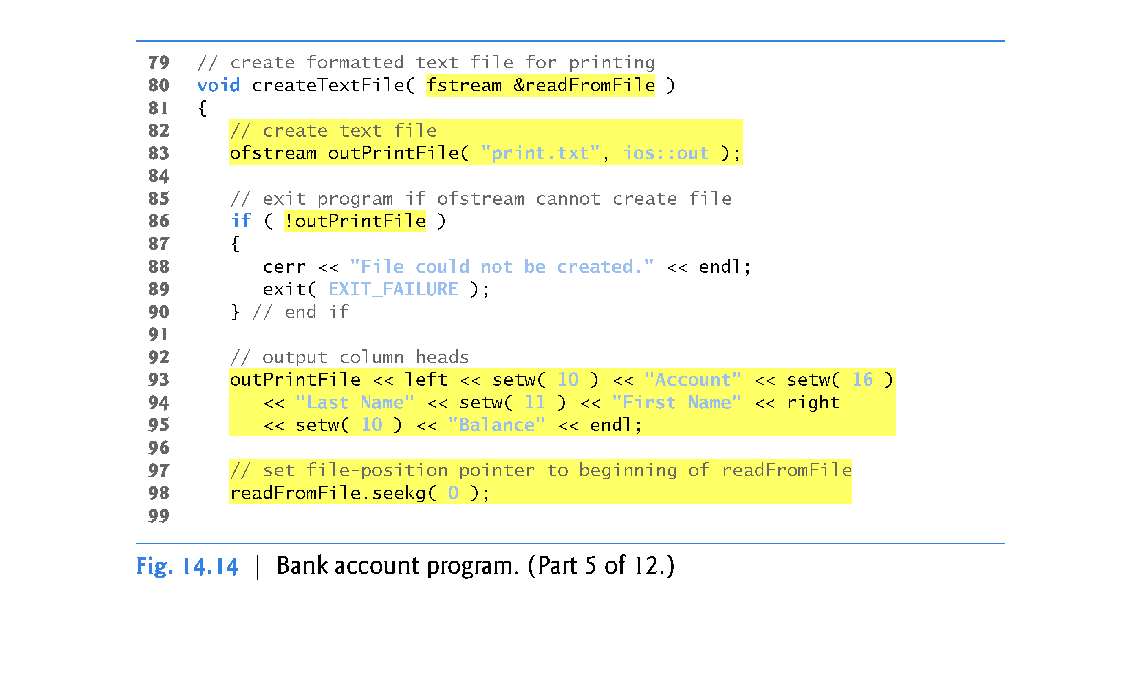

Slide 98
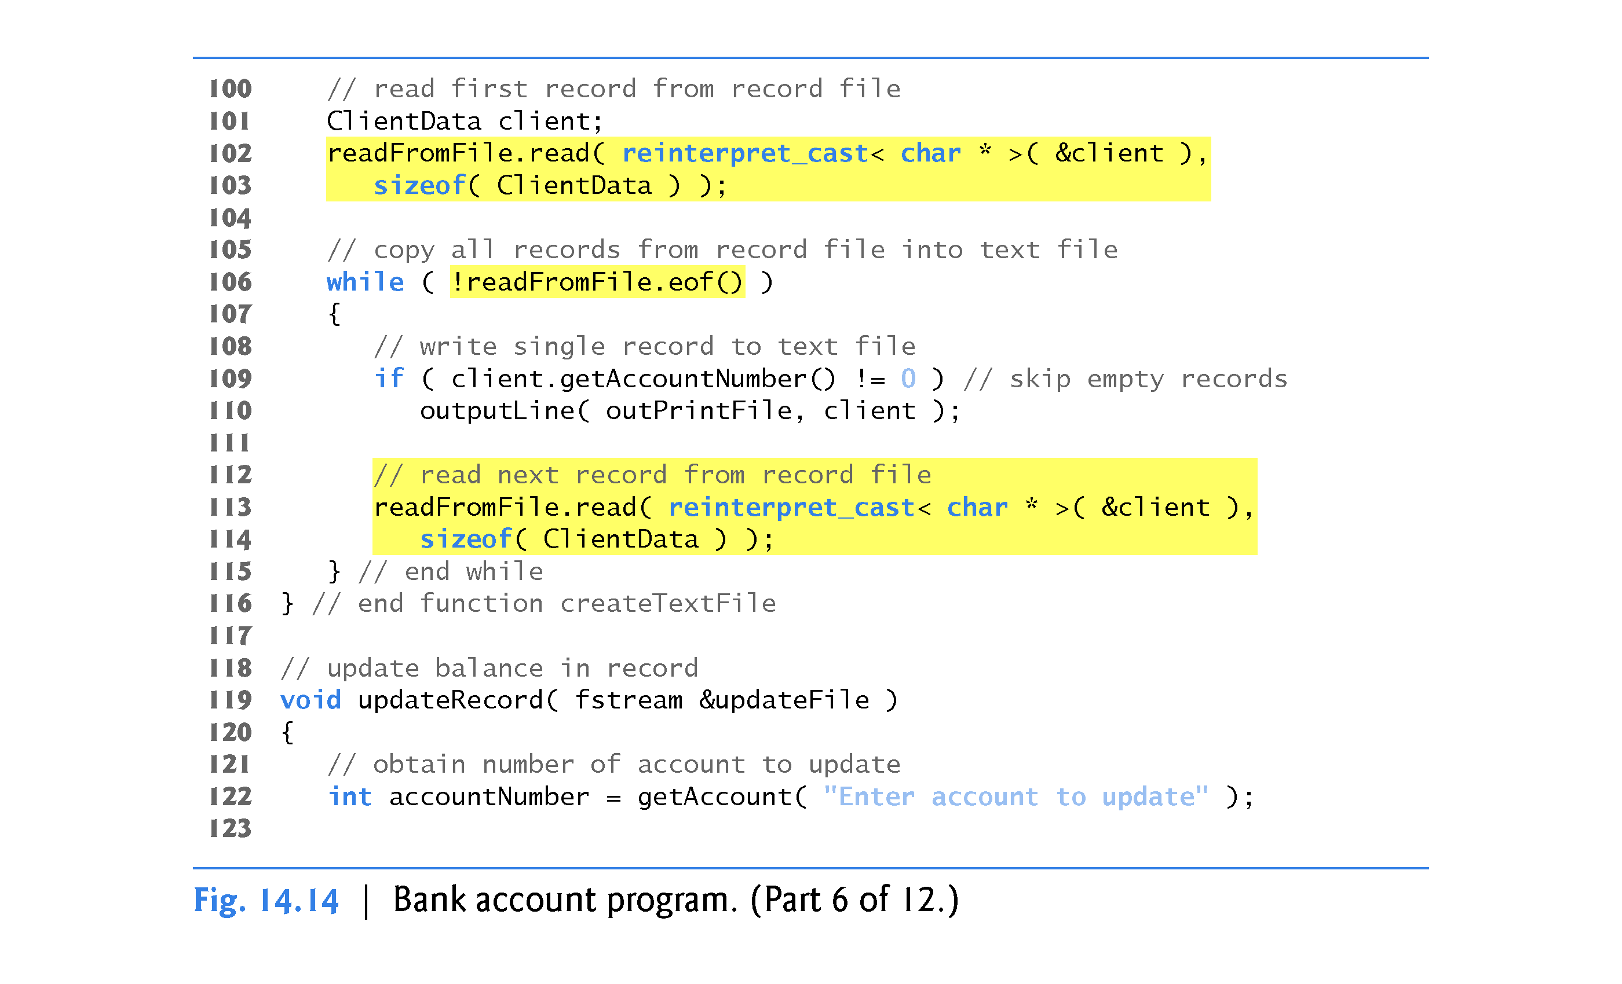

Slide 99
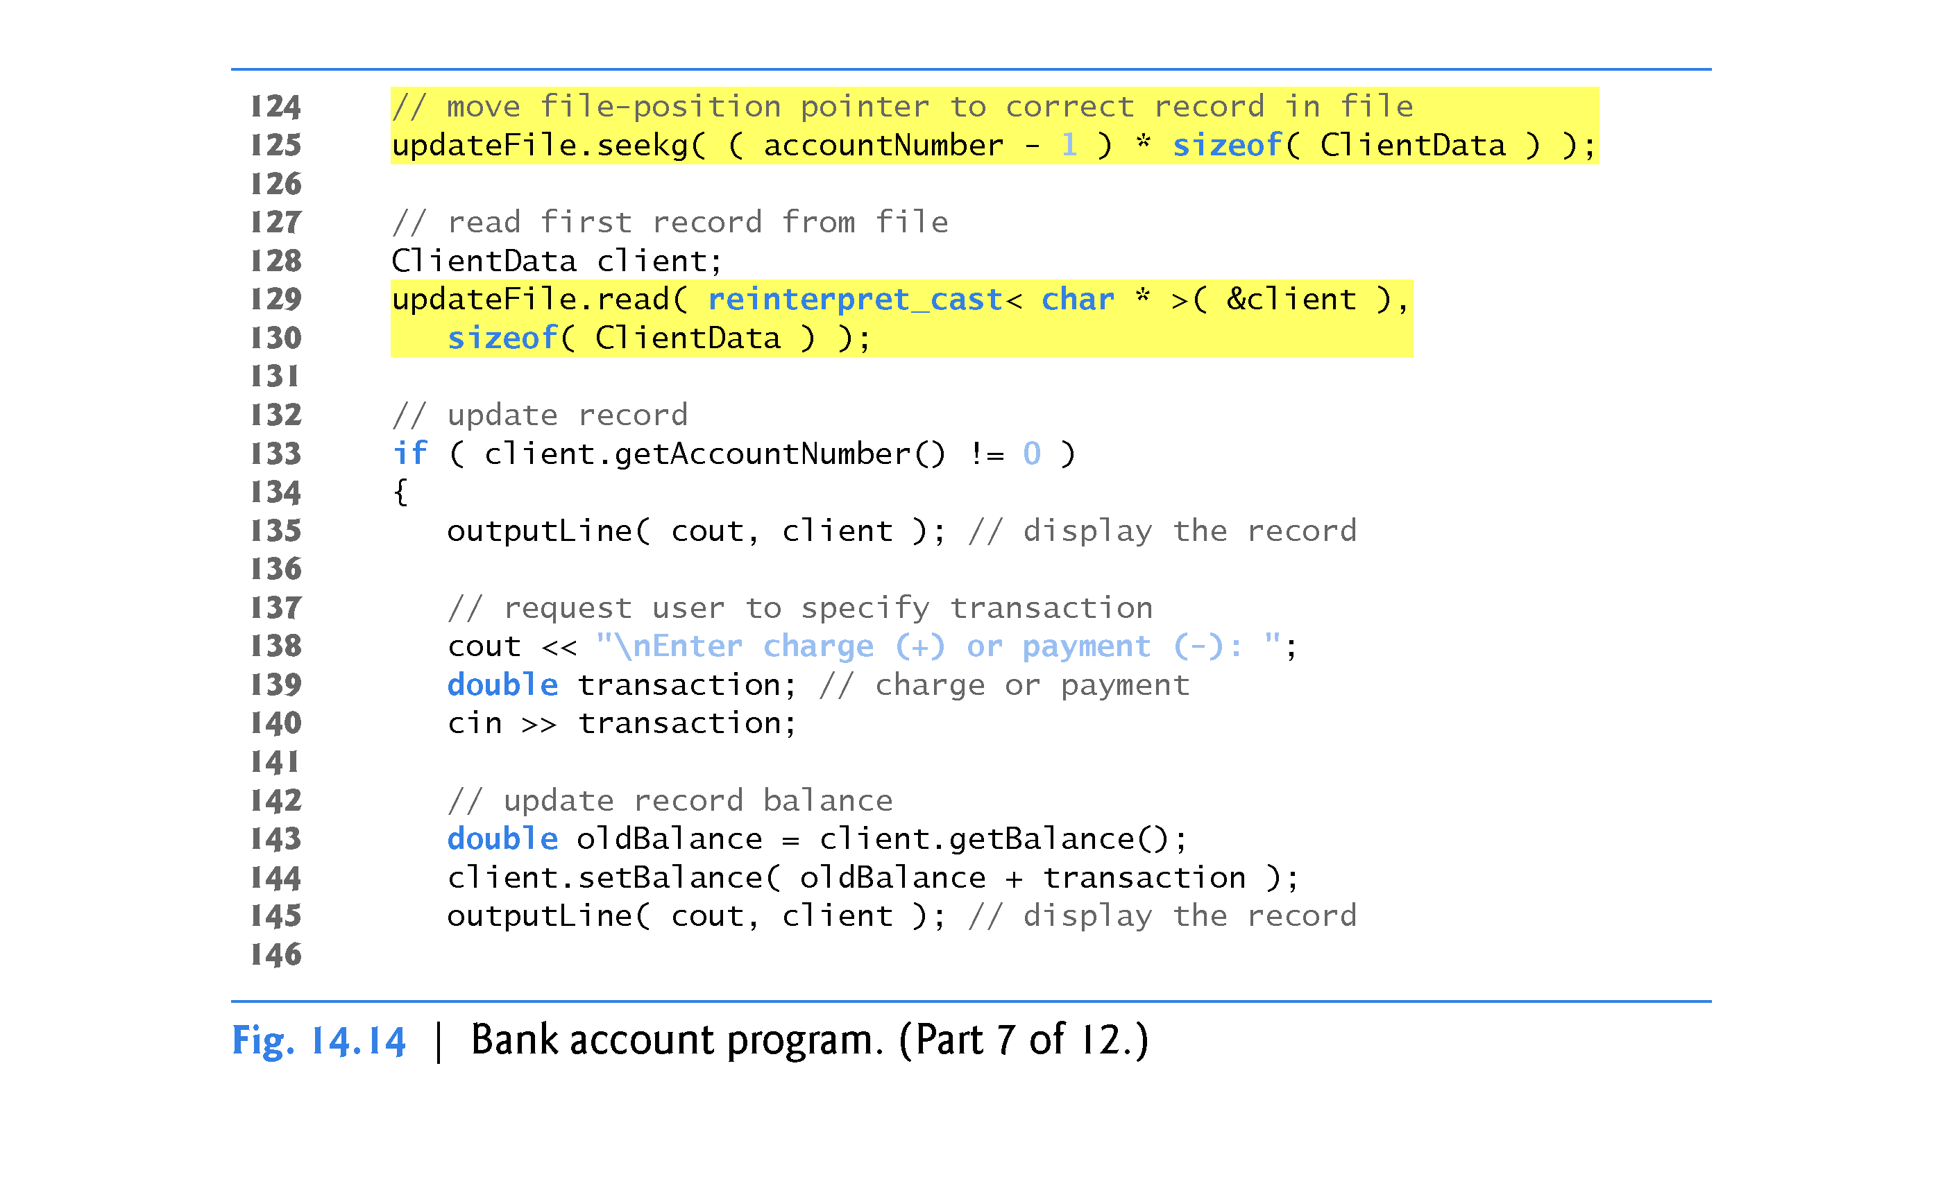

Slide 100
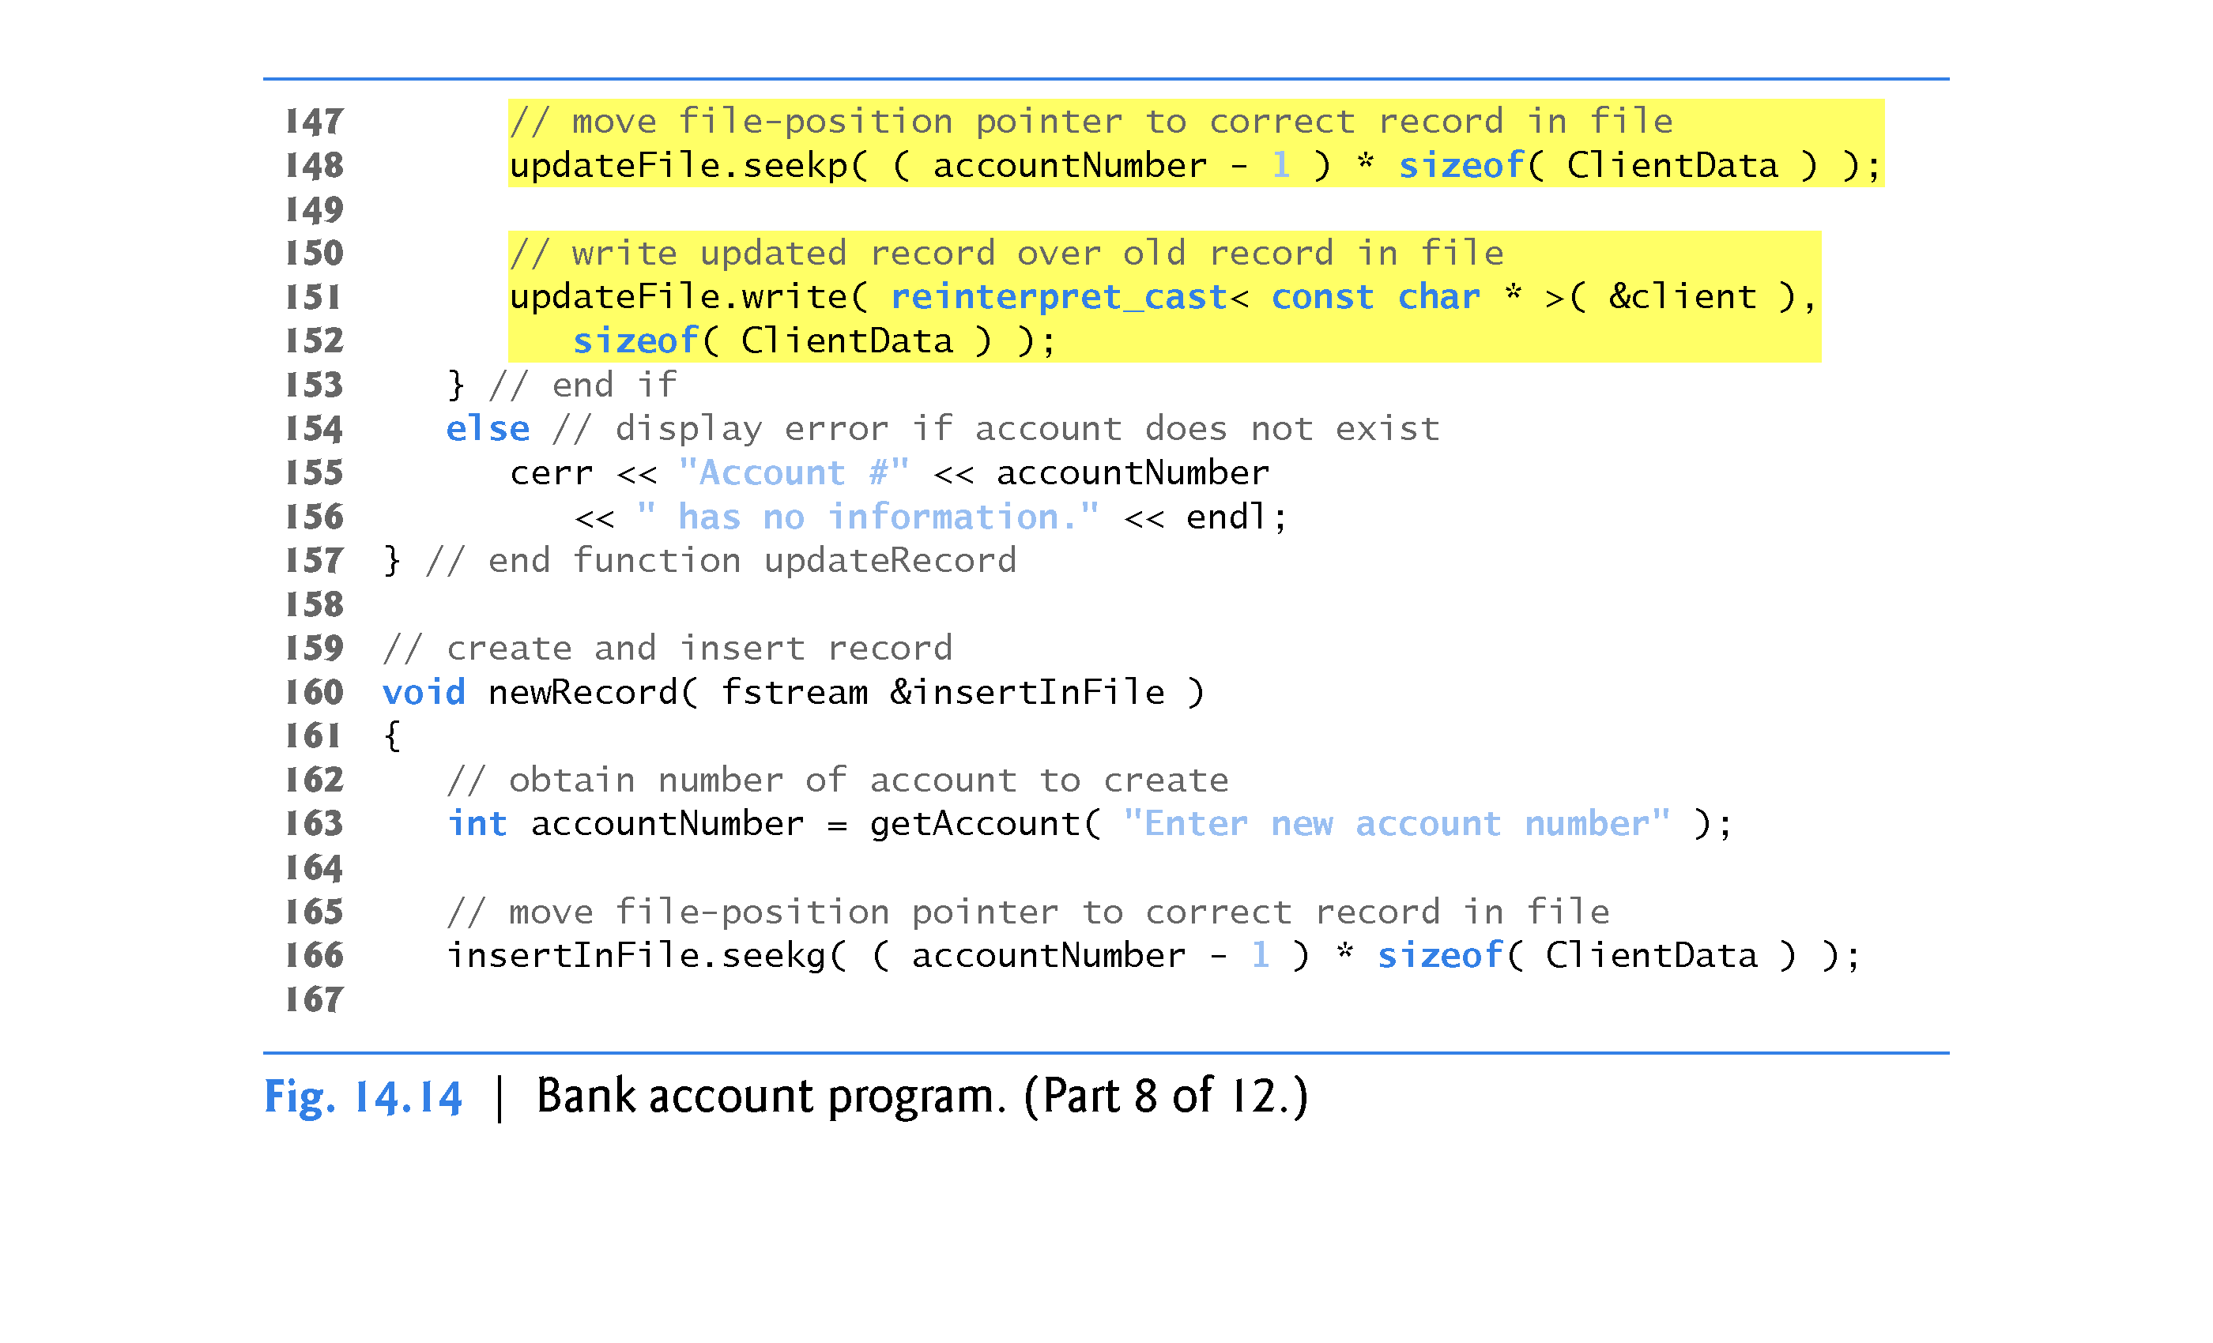

Slide 101


Slide 102


Slide 103


Slide 104


Slide 105
14.10 Case Study: A Transaction-Processing Program
The program has five options (Option 5 is for terminating the program).
Option 1 calls function createTextFile to store a format-ted list of all the account information in a text file called print.txt that may be printed.
Function createTextFile (lines 80–116) takes an fstream object as an argument to be used to input data from the credit.dat file.
Function createTextFile invokes istream member function read (lines 102–103) and uses the sequential-file-access techniques of Fig. 14.13 to input data from credit.dat.
Function outputLine, discussed in Section 14.9, is used to output the data to file print.txt.
Note that function createTextFile uses istream member function seekg (line 98) to ensure that the file-position pointer is at the beginning of the file.

Slide 106
14.10 Case Study: A Transaction Processing Program
Option 2 calls updateRecord (lines 119–157) to update an account.
This function updates only an existing record, so the function first determines whether the specified record is empty.
If the record contains information, line 135 displays the record, using function outputLine, line 140 inputs the transaction amount and lines 143–152 calculate the new balance and rewrite the record to the file.
Option 3 calls function newRecord (lines 160–202) to add a new account to the file.
If the user enters an account number for an existing account, newRecord displays an error message indicating that the account exists (lines 200–201).
This function adds a new account in the same manner as the program of Fig. 14.12.

Slide 107
14.10 Case Study: A Transaction-Processing Program
Option 4 calls function deleteRecord (lines 205–236) to delete a record from the file.
Line 208 prompts the user to enter the account number.
Only an existing record may be deleted, so, if the specified account is empty, line 235 displays an error message.
If the account exists, lines 221–230 reinitialize that account by copying an empty record (blankClient) to the file.
Line 232 displays a message to inform the user that the record has been deleted.

Slide 108
14.11 Object Serialization
This chapter and Chapter 13 introduced the object-oriented style of input/output.
An object’s member functions are not input or output with the object’s data; rather, one copy of the class’s member functions remains available internally and is shared by all objects of the class.
When object data members are output to a disk file, we lose the object’s type information.
We store only the values of the object’s attributes, not type information, on the disk.
If the program that reads this data knows the object type to which the data corresponds, the program can read the data into an object of that type as we did in our random-access file examples.

Slide 109
14.11 Object Serialization (cont.)
An interesting problem occurs when we store objects of different types in the same file.
How can we distinguish them (or their collections of data members) as we read them into a program?
The problem is that objects typically do not have type fields (we discussed this issue in Chapter 12).
One approach used by several programming languages is called object serialization.
A so-called serialized object is an object represented as a sequence of bytes that includes the object’s data as well as information about the object’s type and the types of data stored in the object.
After a serialized object has been written to a file, it can be read from the file and deserialized - that is, the type information and bytes that represent the object and its data can be used to recreate the object in memory.

Slide 110
14.11 Object Serialization (cont.)
C++ does not provide a built-in serialization mechanism; however, there are third party and open source C++ libraries that support object serialization.
The open source Boost C++ Libraries (www.boost.org) provide support for serializing objects in text, binary and extensible markup language (XML) formats (www.boost.org/libs/serialization/doc/index.html).

